Slide 1
Upazila Health Complex
Welcome To
Ramgati Lakshmipur
31 Bed Hospital, Char Alexandar

Slide 2
Organogram of upazila health complex

Slide 3
Health workforce of Ramgati upazila Health complex
Doctor – 15 ( one in CMC deputation , one in Sadar hospital)
Nurse 10 (one in Sadar hospital)
Midwife – 0 ( 2 posted as attachment at UHC Ramgati)
SACMO 8
Head Assistant-1
HI-1
EPI-1
AHI-5
HA -23
SBA-4(HA)
CHCP 18 ( SBA -2 )
MLSS-0
Cleaner-2
Outsourcing-5

Slide 4
Health institutions
Health complex : 1
H&FWC -5
Community clinic-20
Union SUB CENTRE-2
NON GOVT CLINIC-0

Slide 5
OUR AIM AND VISION
To ensure primary health care at root level and maintain the referral system

Slide 6
Our services at a glance
Pathology Lab
24 hour emergency department
Indoor
Outdoor
Dental OPD
Pharmacy
EPI
Diagnostic facility
      Pathology
      Radiology
      ECG
      Ultrasonography
Emergency Ambulance
Dr performing USG
X ray Machine
Dental Unit

Slide 7
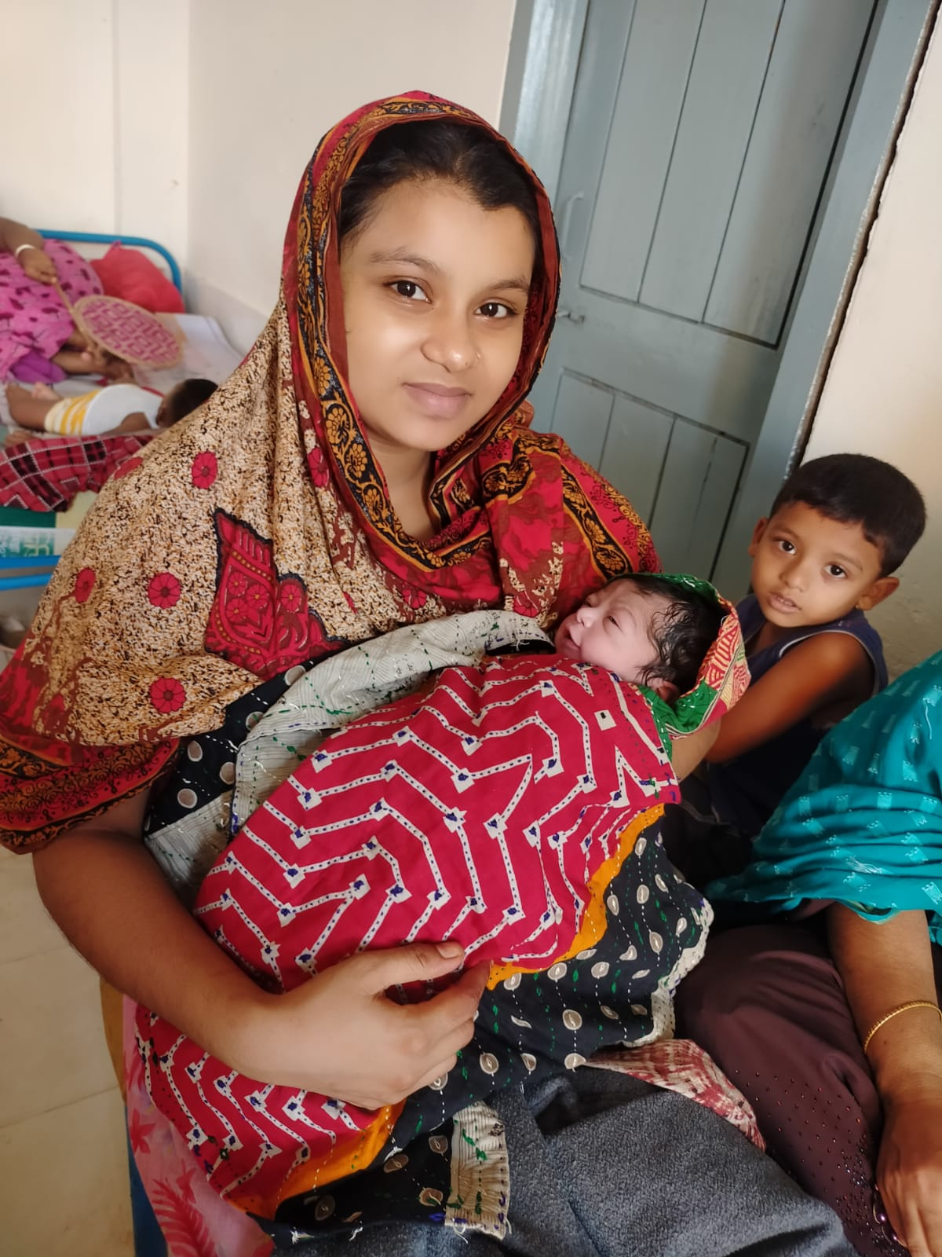
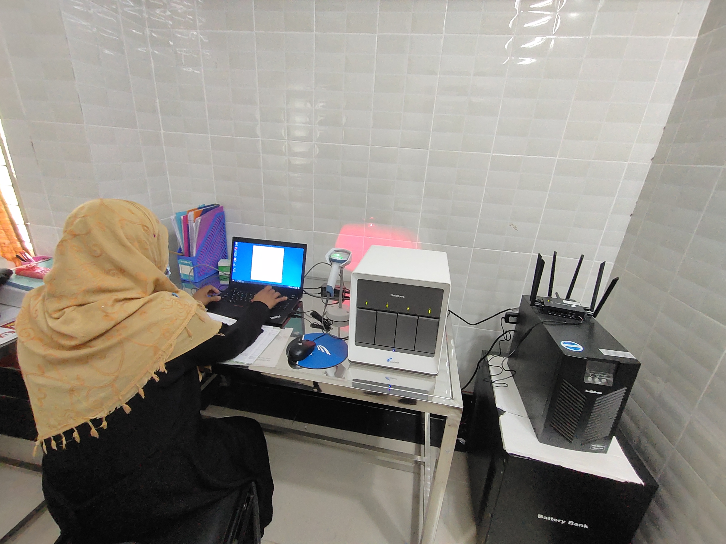
continued
MATERNAL AND CHILD HEALTH MANAGEMENT
          Normal vaginal delivery by skilled birth attendant
          Elective cesarian section
          Cervical cancer screening
          ANC and PNC
Telemedicine
Non Communicable Disease Control Corner
Integrated Management on Child Health (IMCI ) Corner
Tuberculosis screening programme ( Screening via Gene expert machine)
One Stop Crisis Centre
Covid Screening via Rapid antigen test
Rabies immunization
GENE EXPERT TB SCREENING

Slide 8
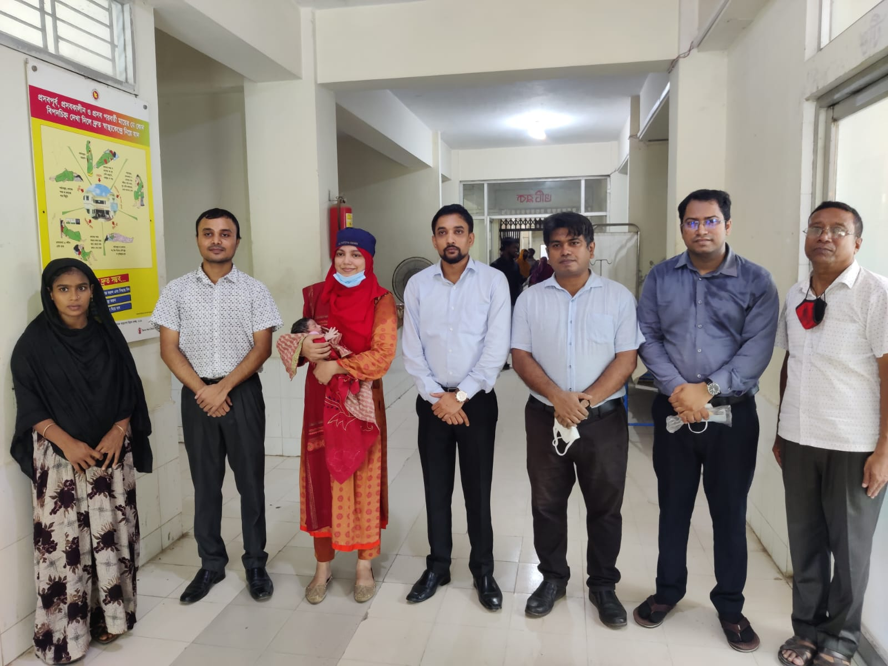
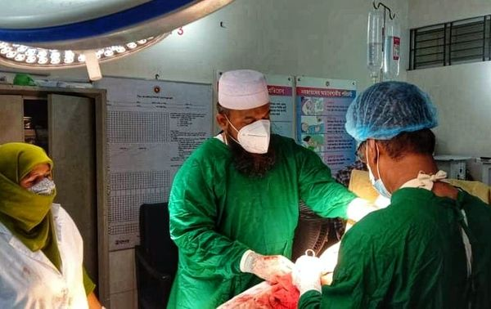
Successful C section at UHC
A challenge but we dream

Slide 9
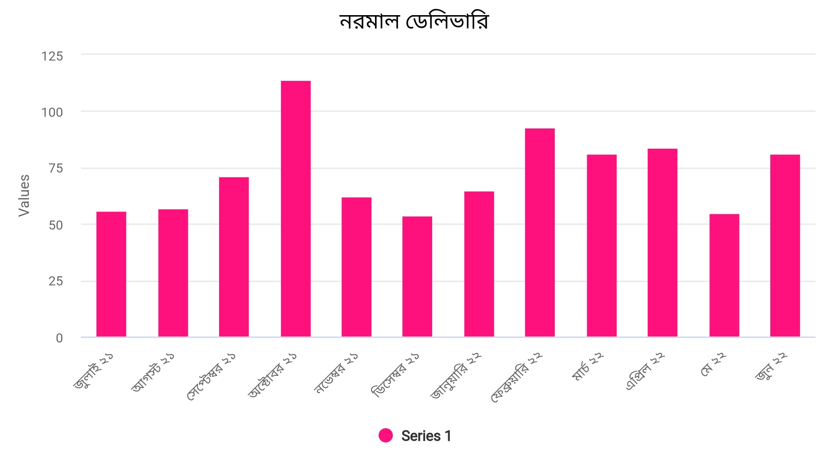
NVD At UHC (July 21-June 22)

Slide 10
TOTAL NUMBER OF HOSPITAL NVD (JULY 21 to August 22)
MONTH | Number of NVD
July 2021 | 56
August 2021 | 57
September 21 | 71
October 21 | 114
November 21 | 62
December 21 | 54
January 22 | 65
February 22 | 92
March 22 | 80
April 22 | 84
May 22 | 53
June 22 | 80
July 22 | 95
August 22 | 94
Total | 1057

Slide 11
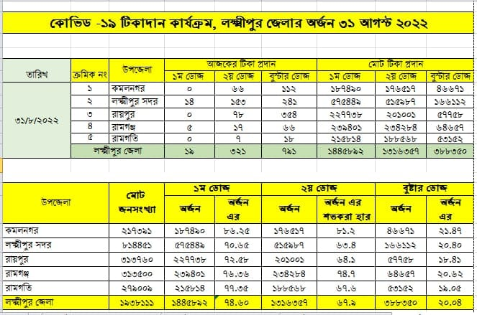
Covid vaccination at UHC

Slide 12
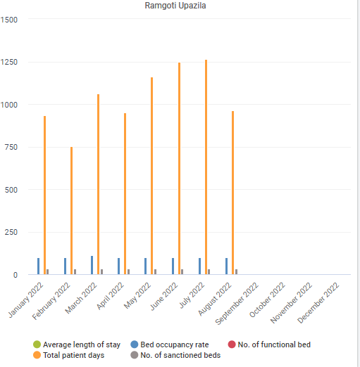
Bed Occupancy Rate

Slide 13
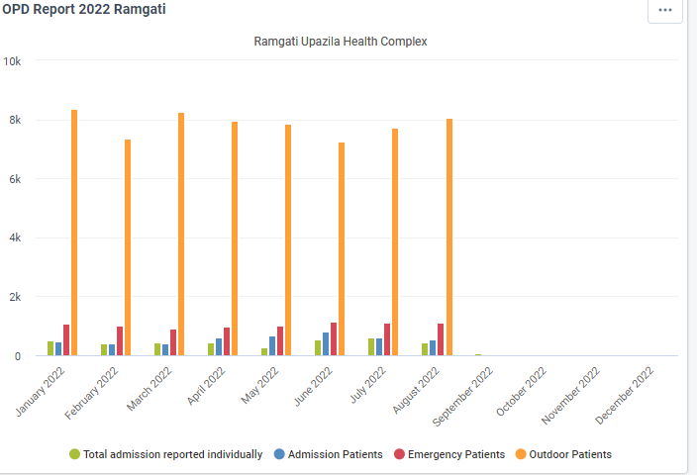
Emergency and Outdoor Service

Slide 14
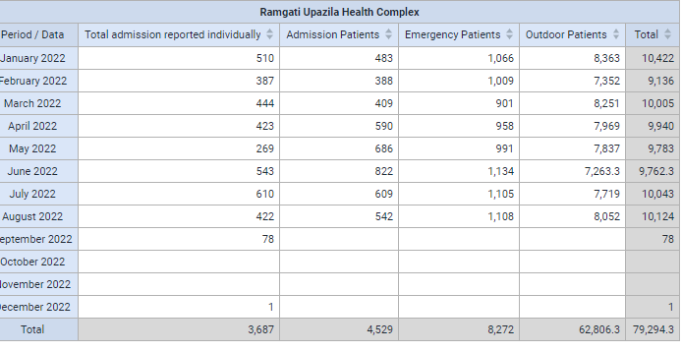
Statistics On OUTDOOR, Emergency And Indoor Patients (Jan to August 2022)

Slide 15
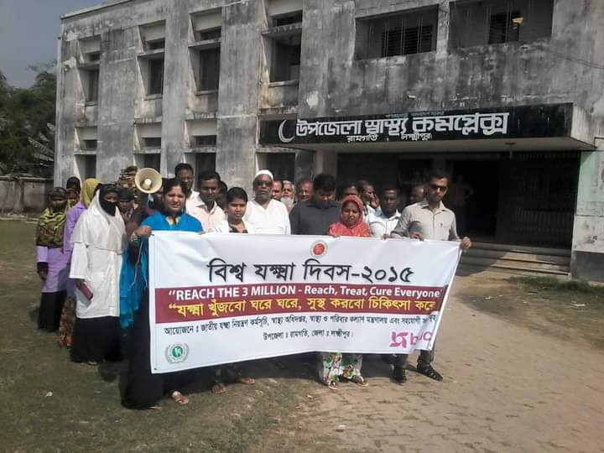
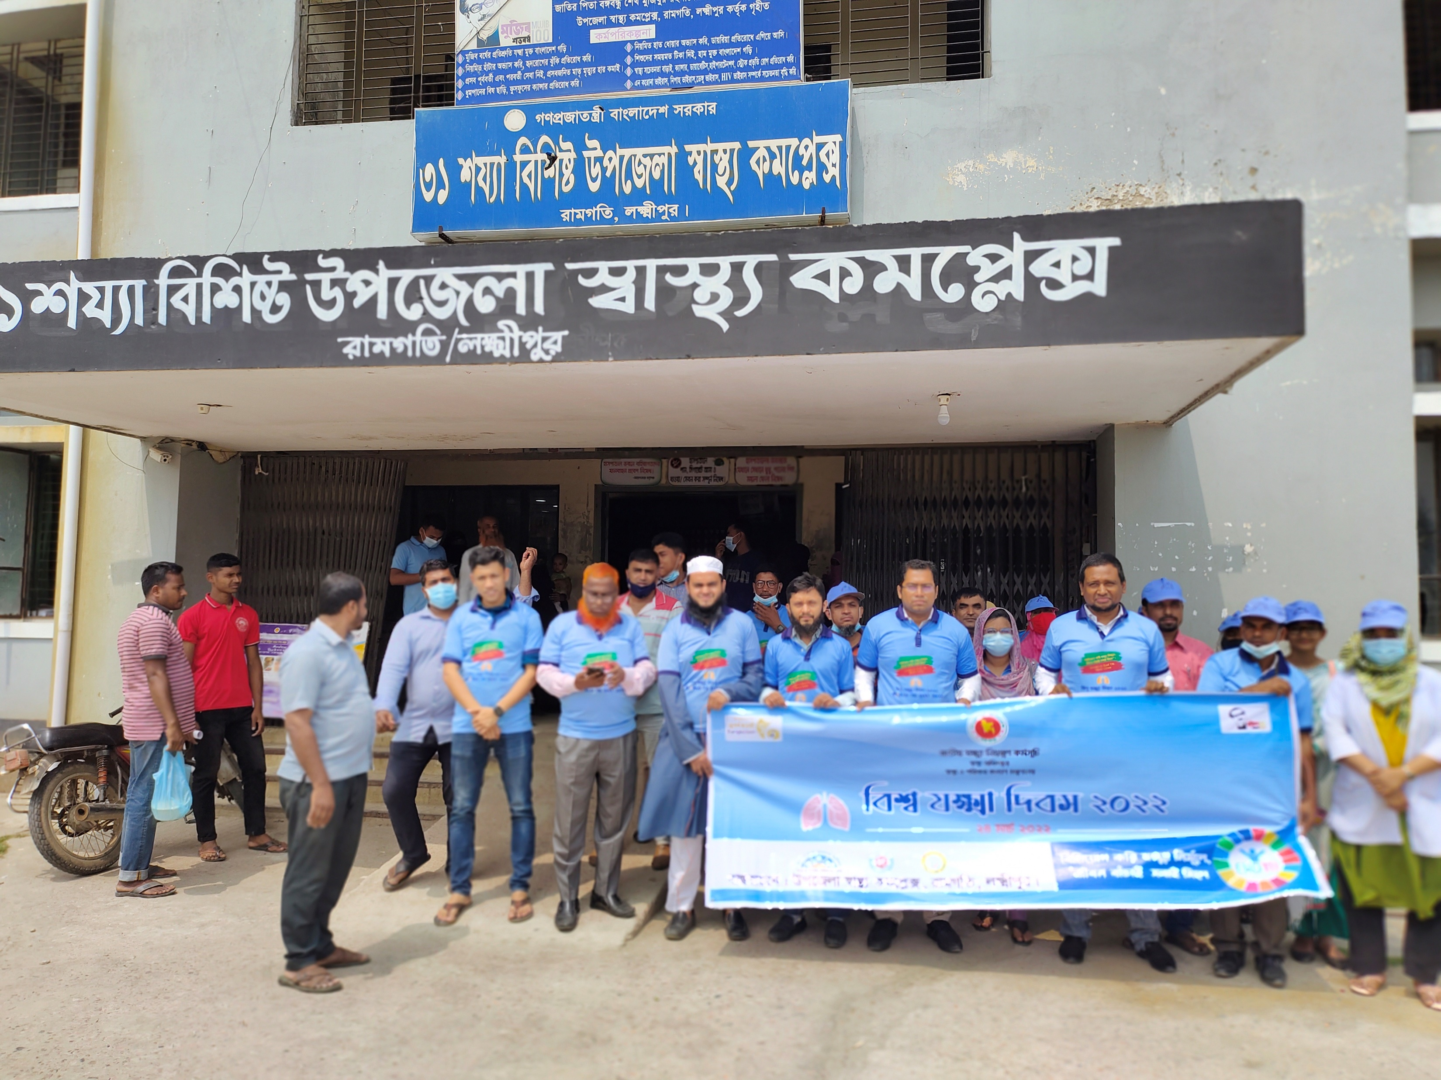
Upazila Health Complex
BEFORE
AT PRESENT

Slide 16
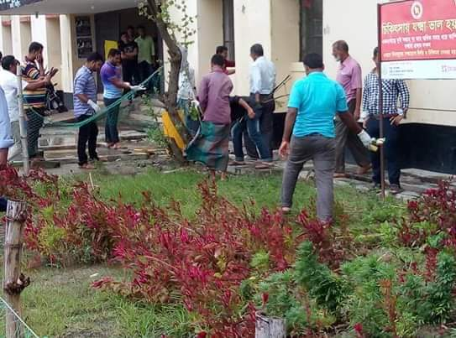
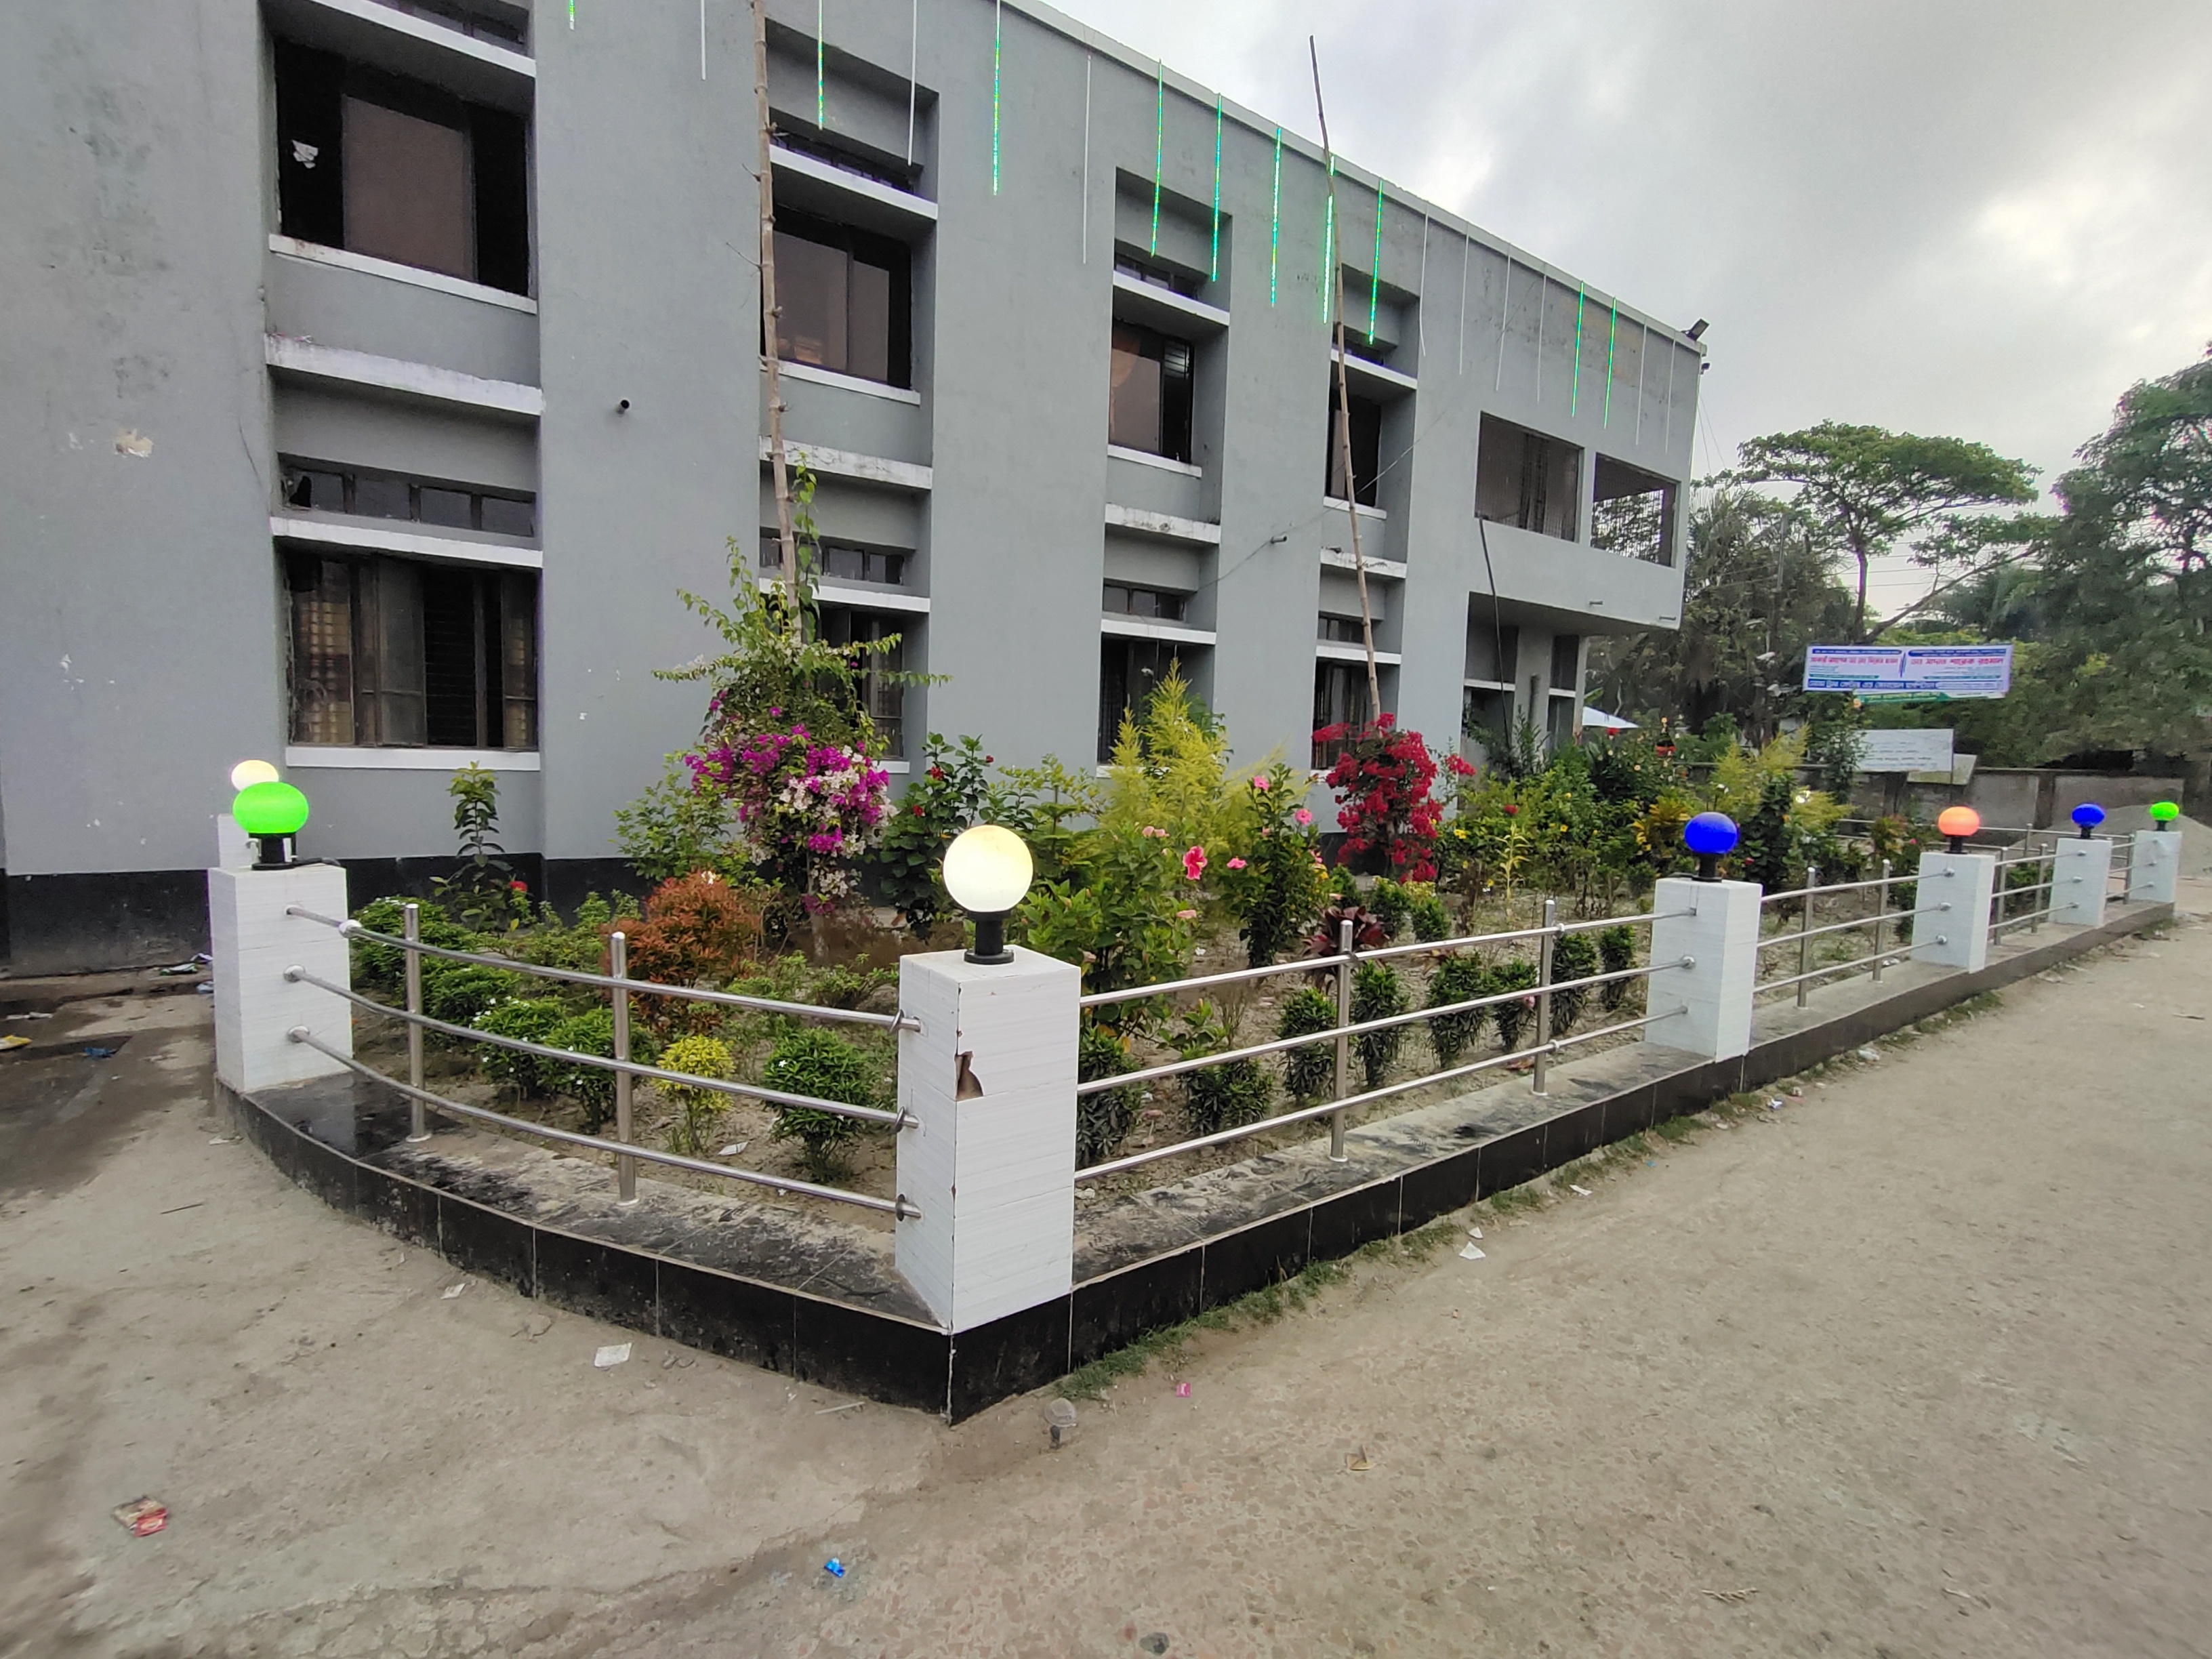
Some changes at a glance
Hospital garden before..
Garden at present

Slide 17
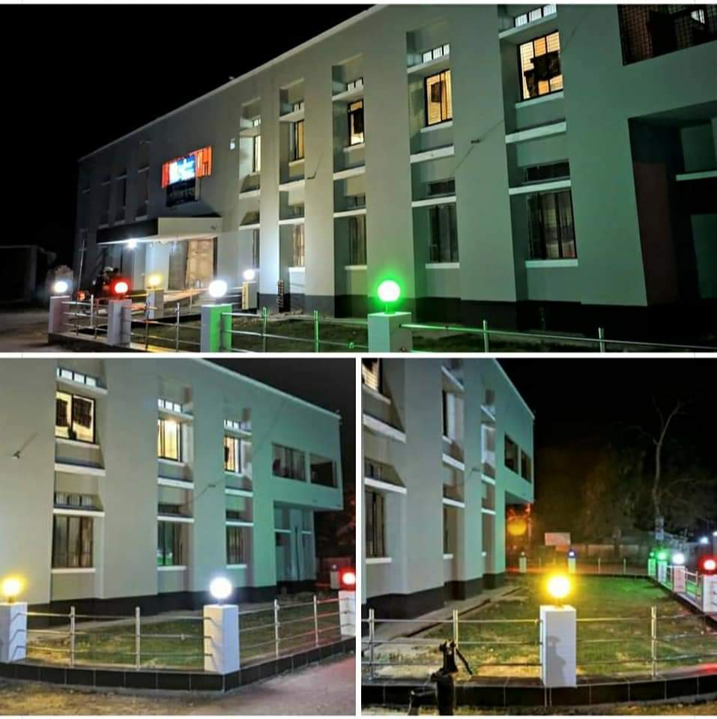
Night View of Health Complex

Slide 18
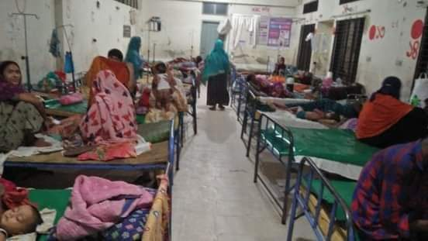
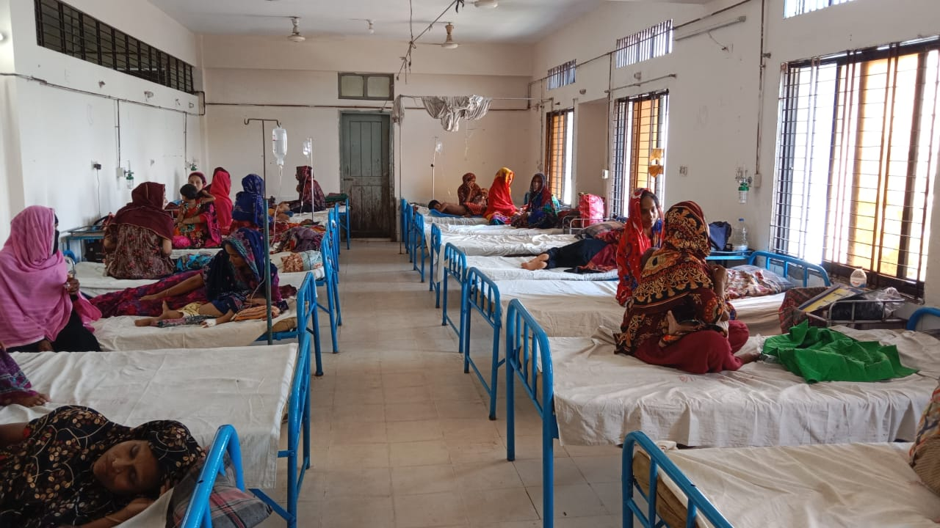
Changes in Indoor
Indoor before
after

Slide 19
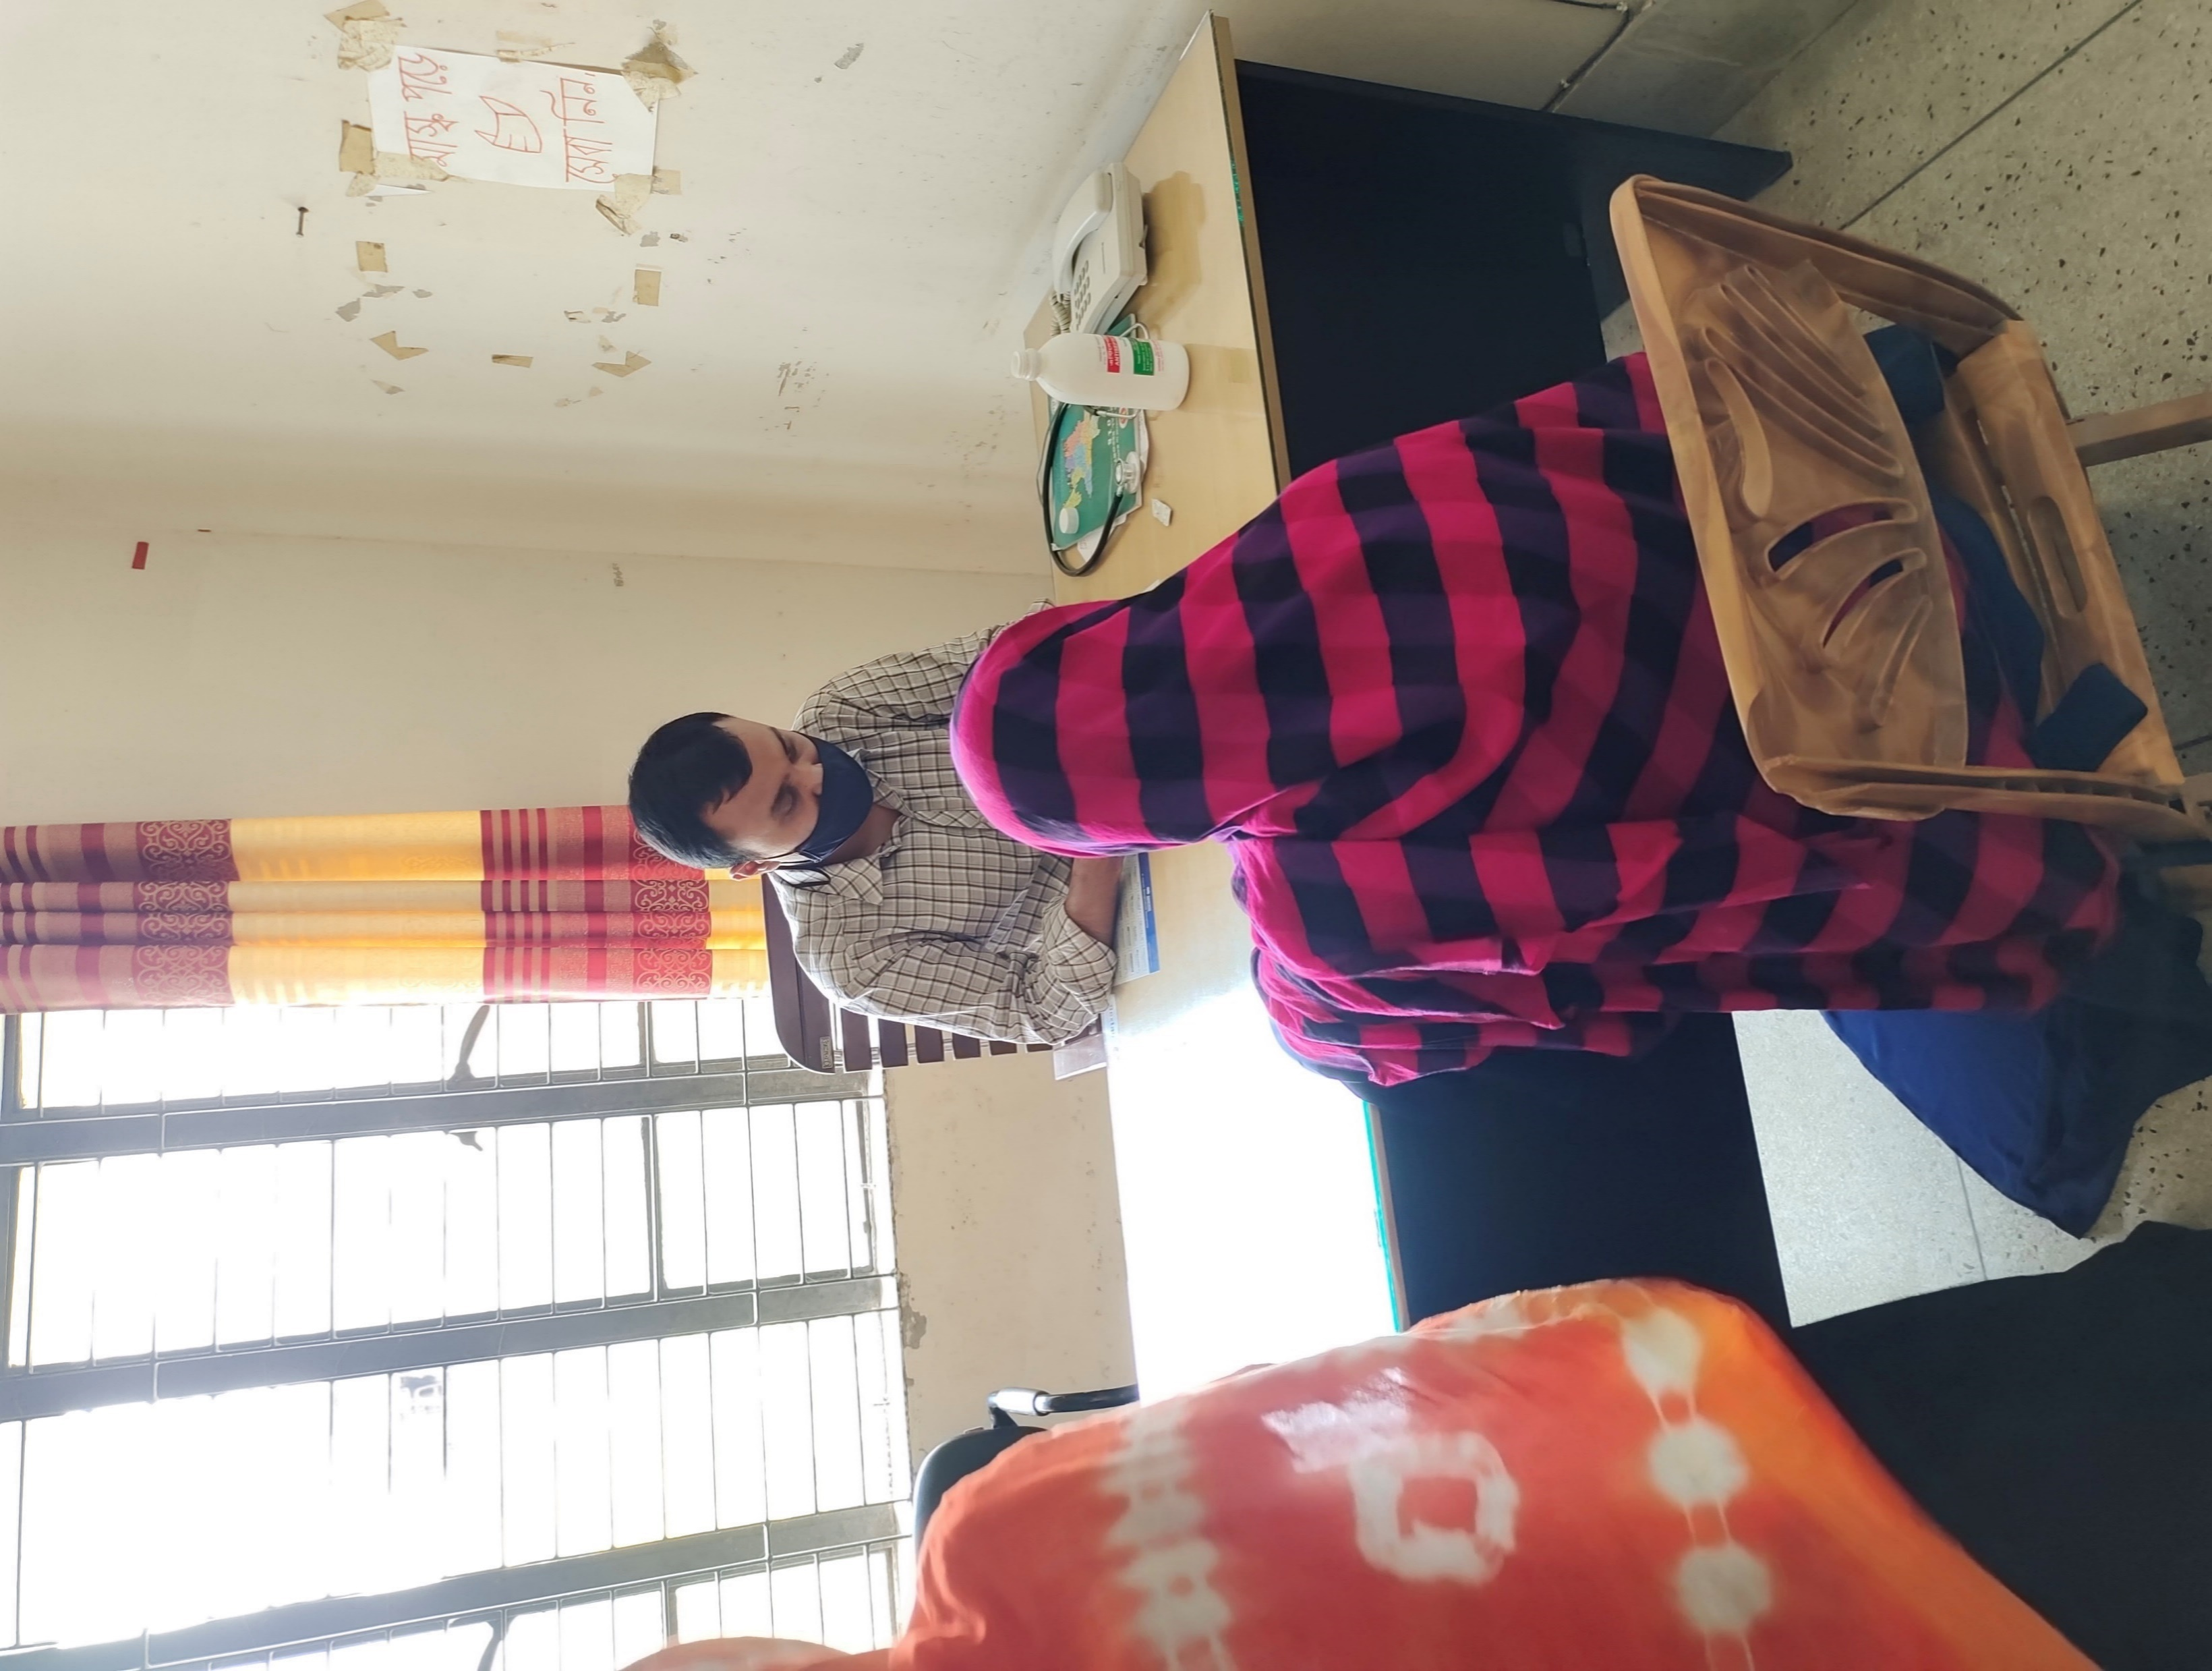
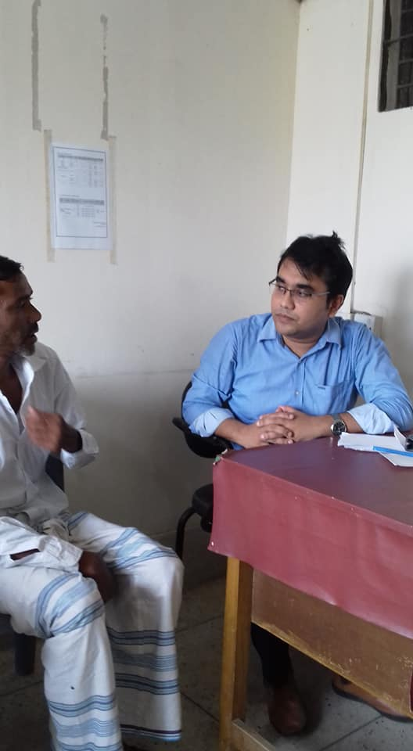
Outdoor Room Changes
BEFORE
AFTER

Slide 20
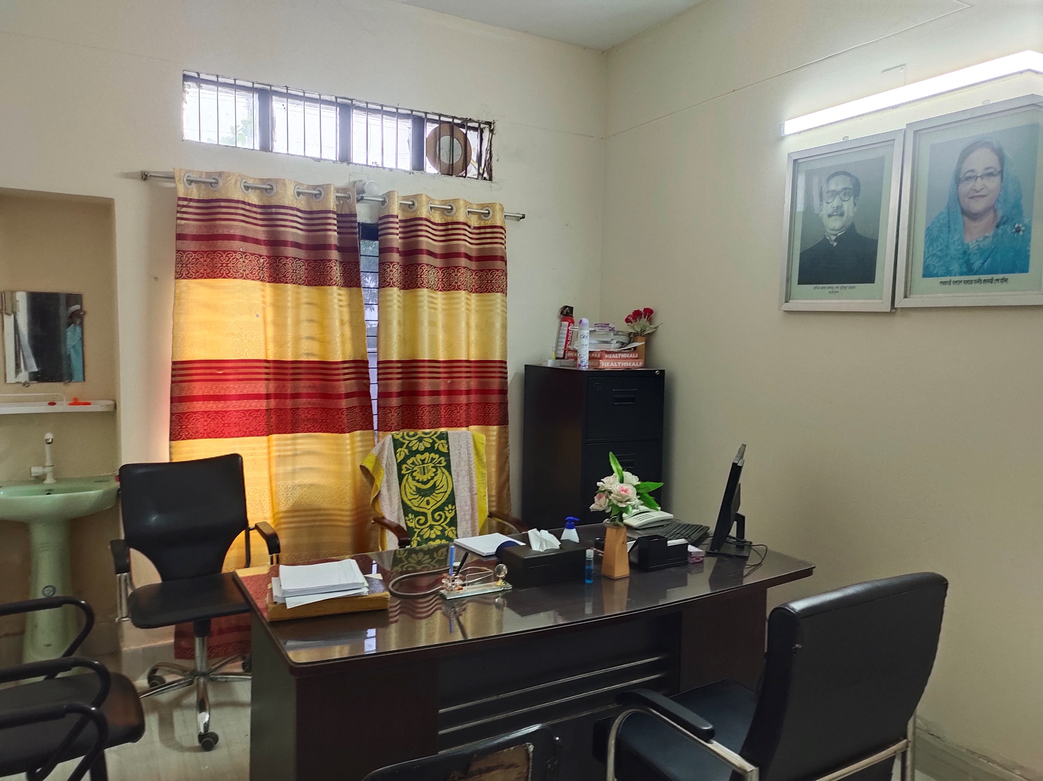
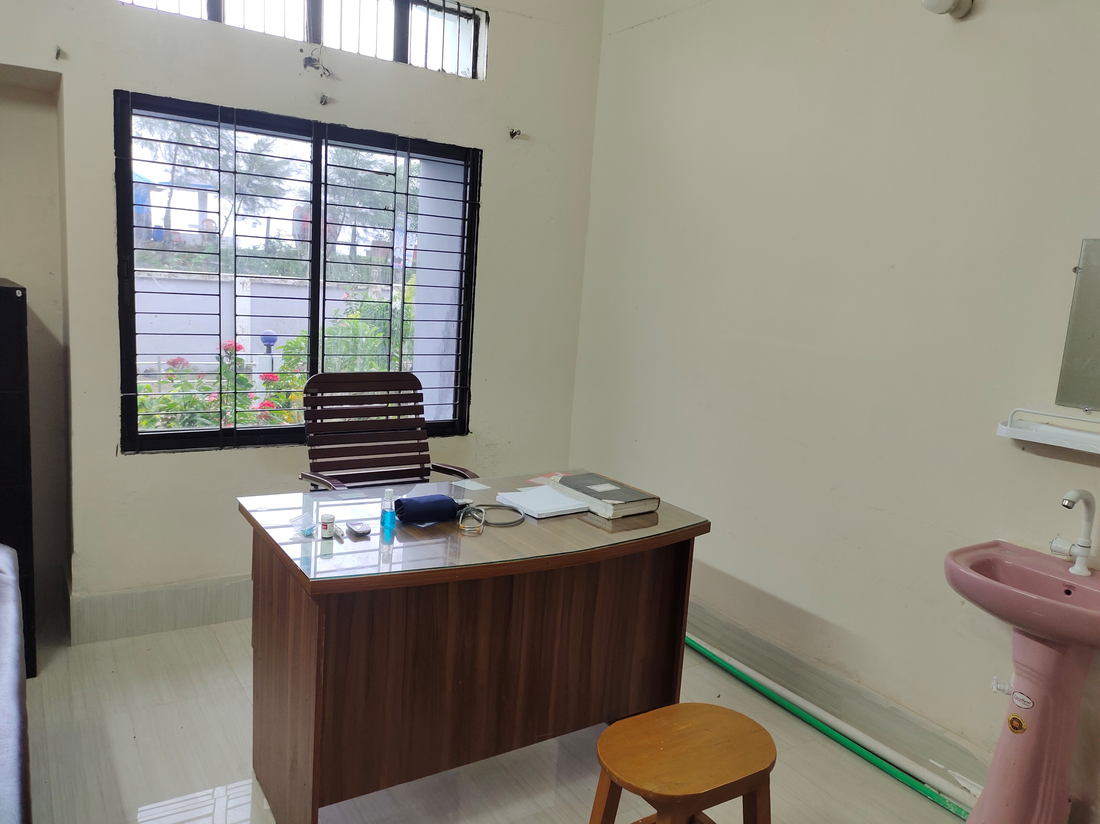
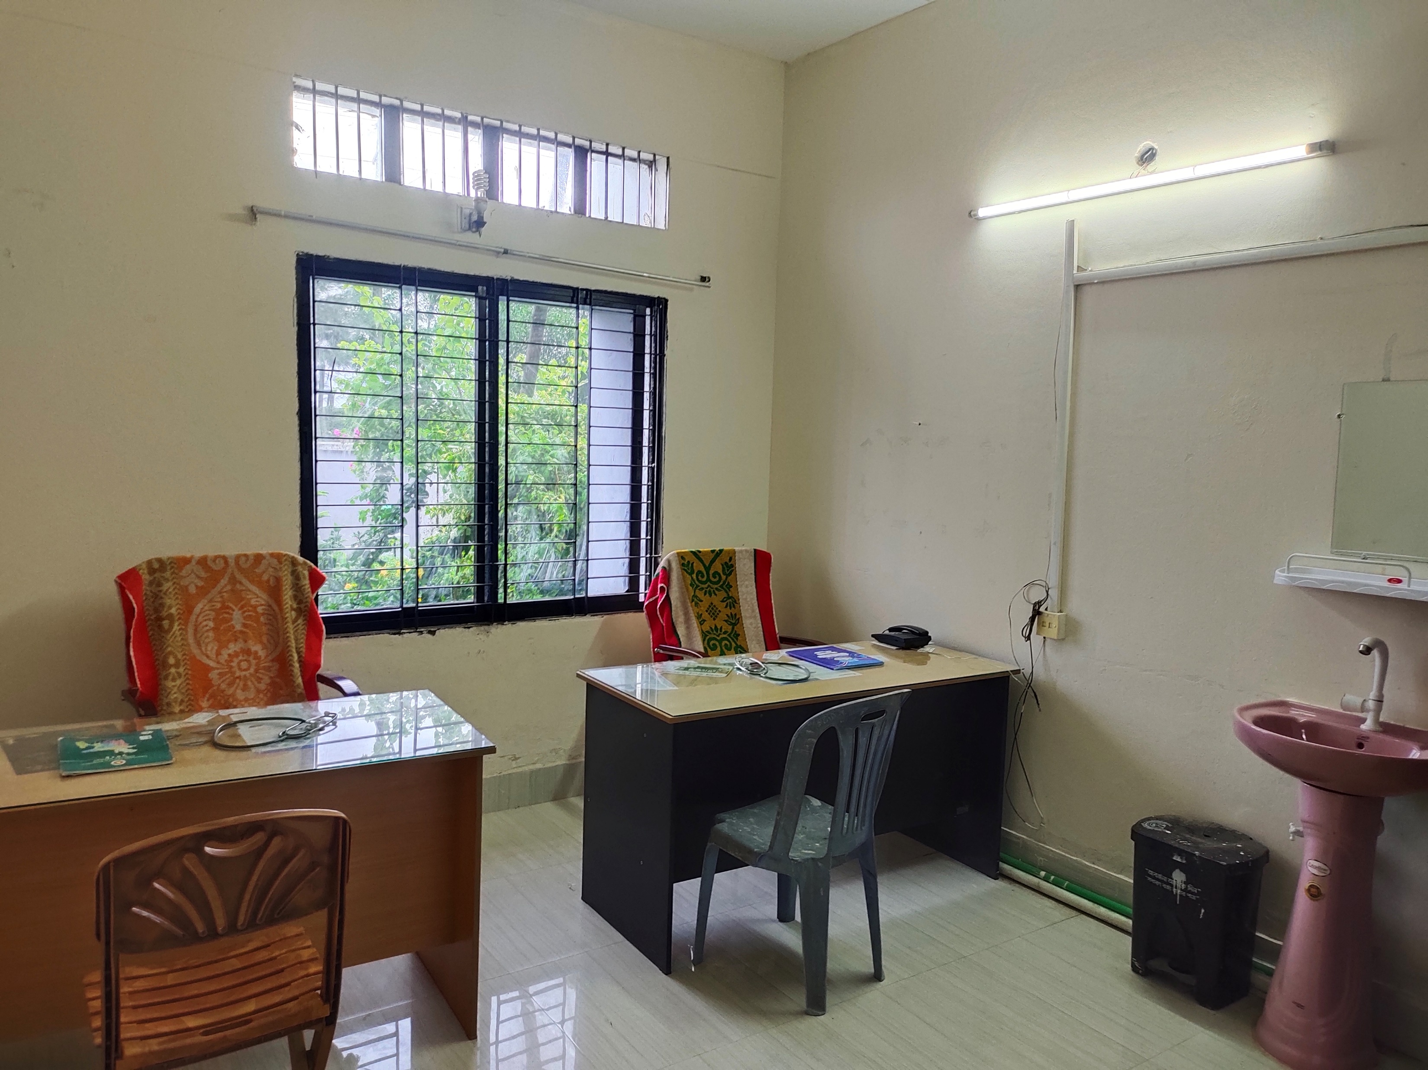
Inner View of Outdoor Rooms
RMO ROOM
NCDC CORNER
MALE AND FEMALE OUTDOOR ROOM

Slide 21
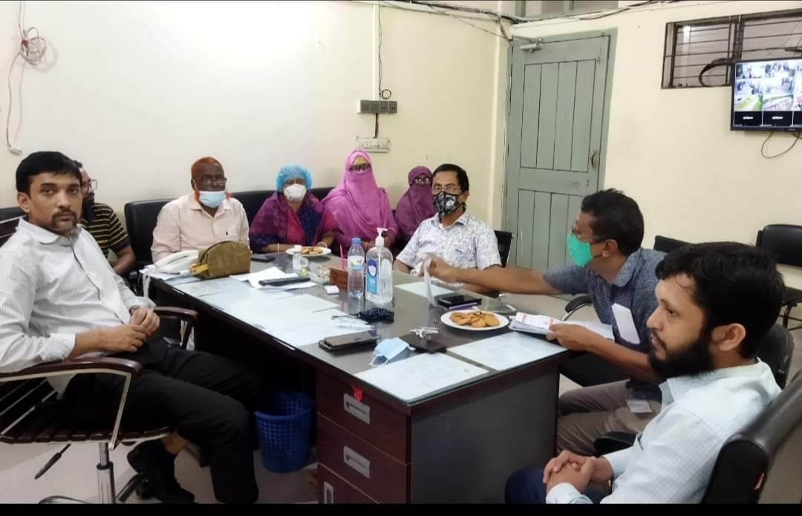
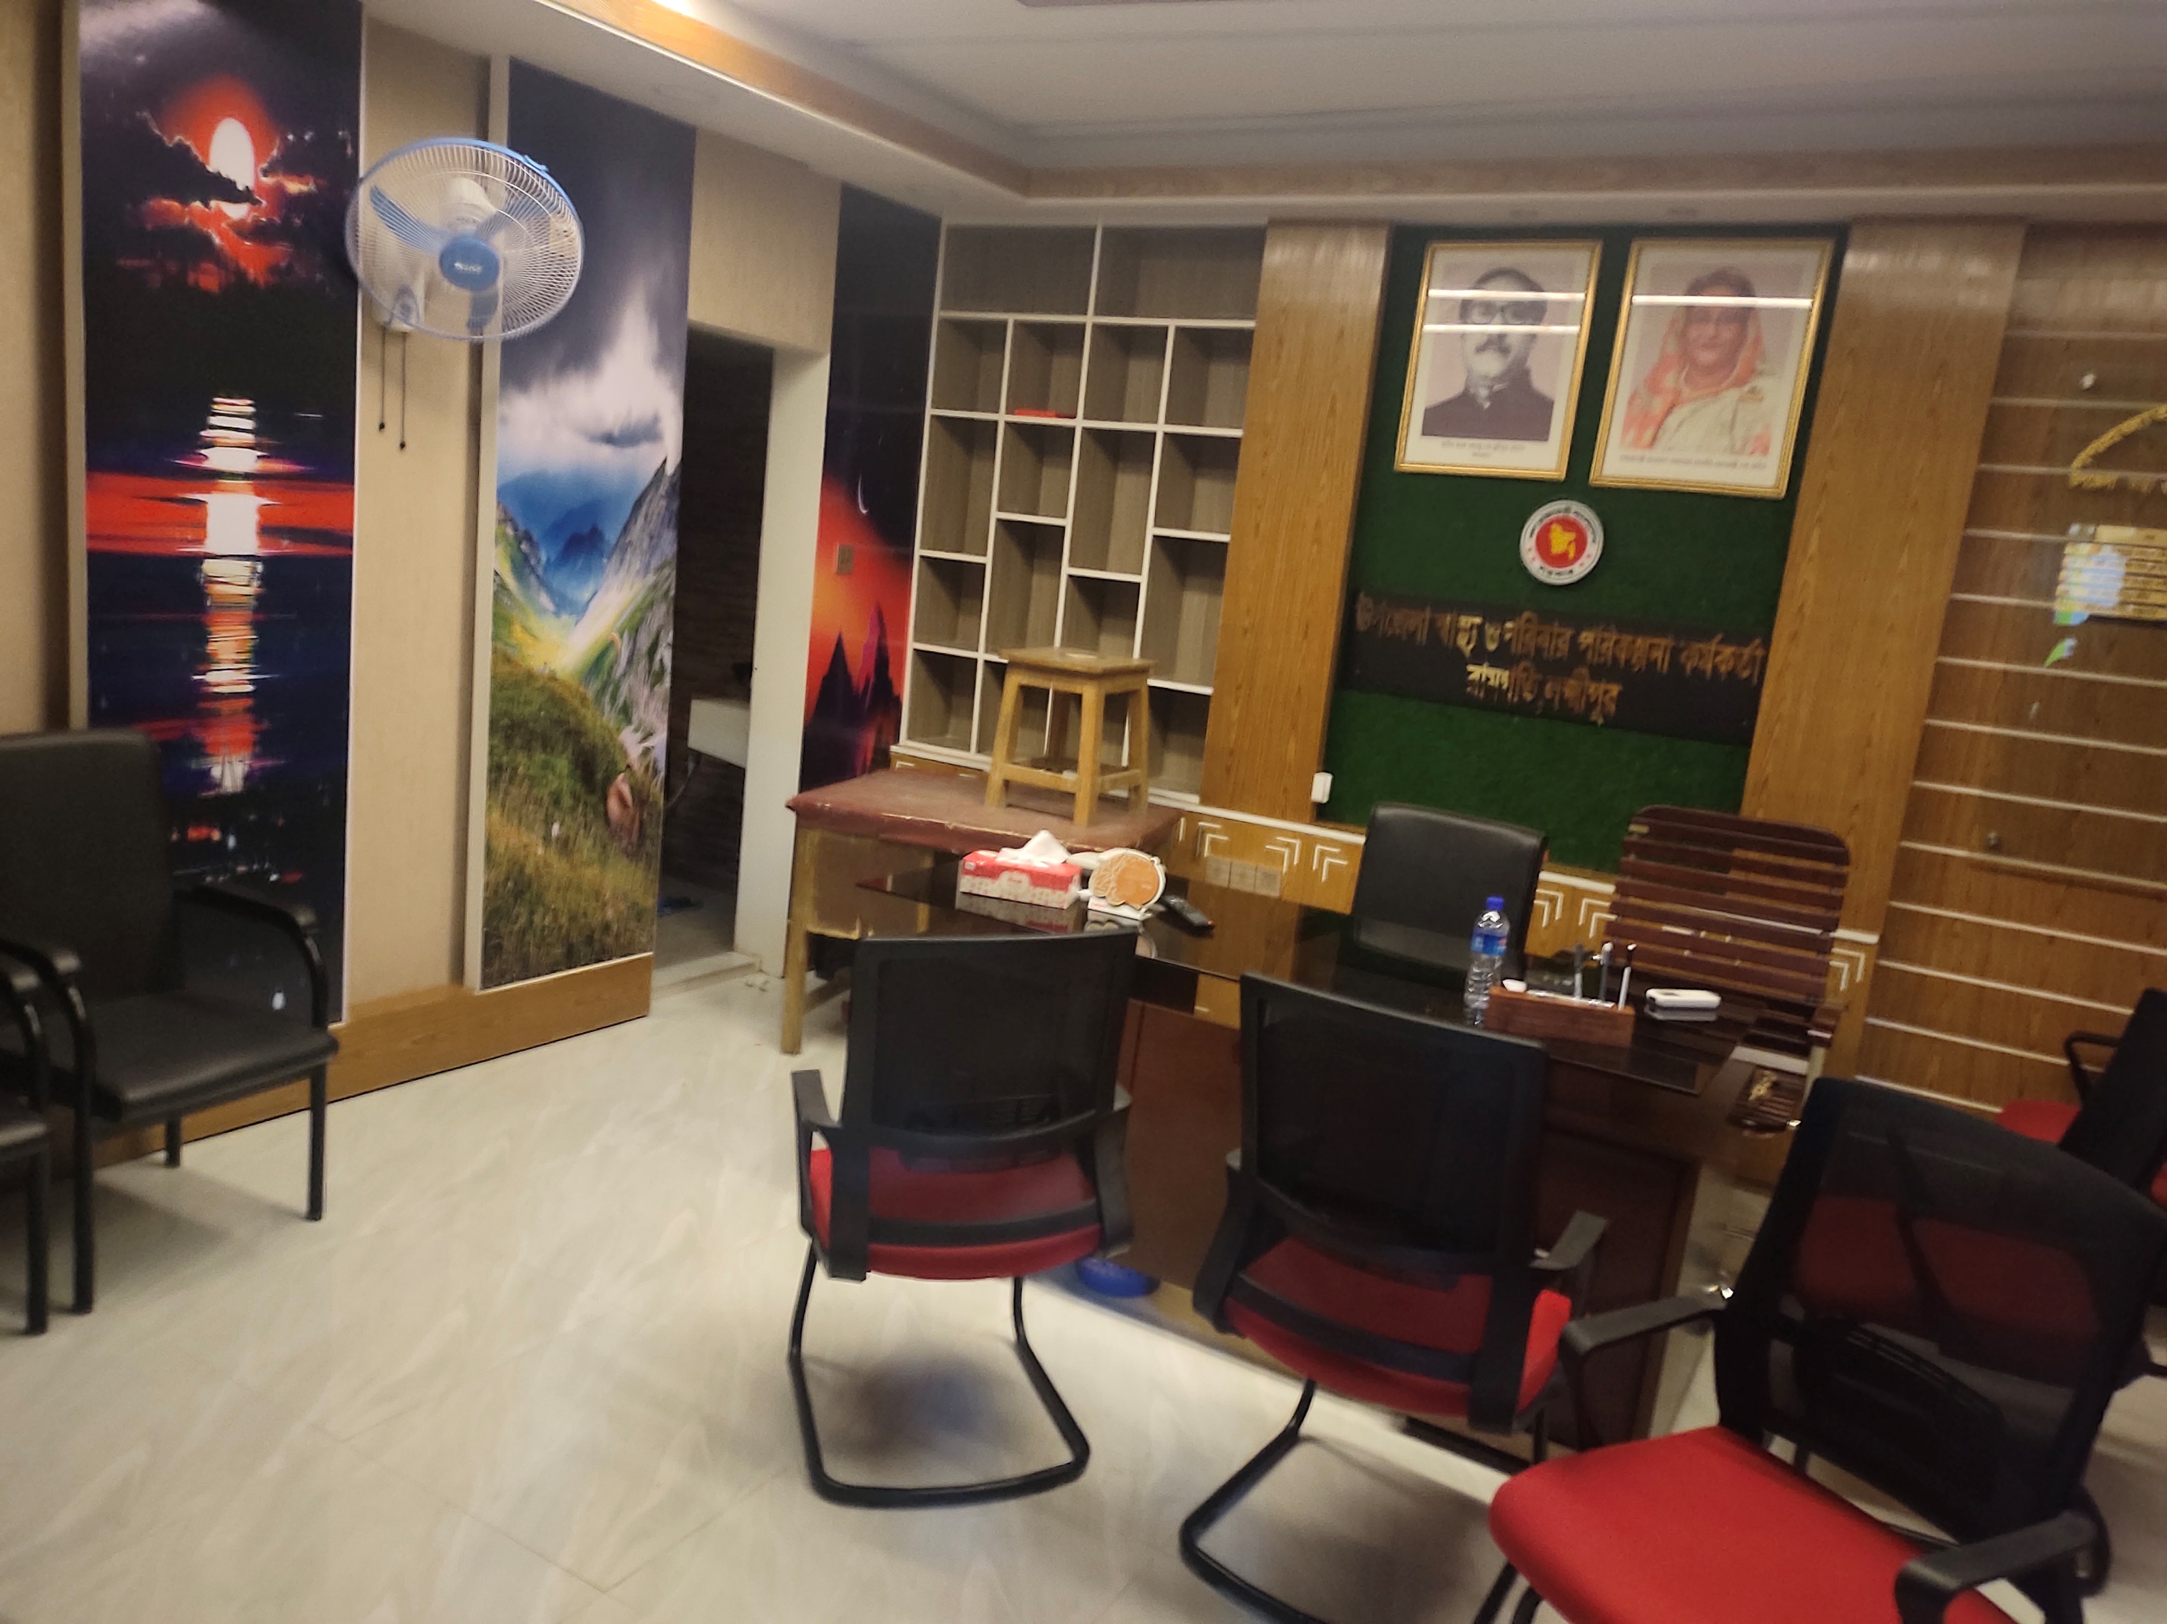
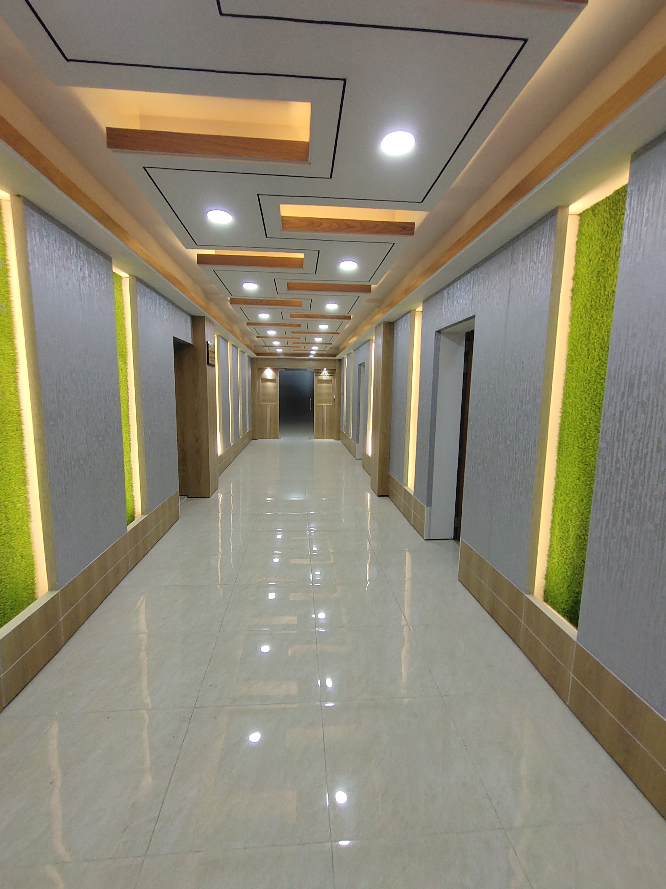
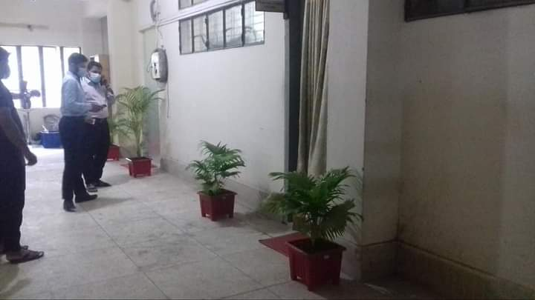
Changes at UHFPO Office
Before
After

Slide 22
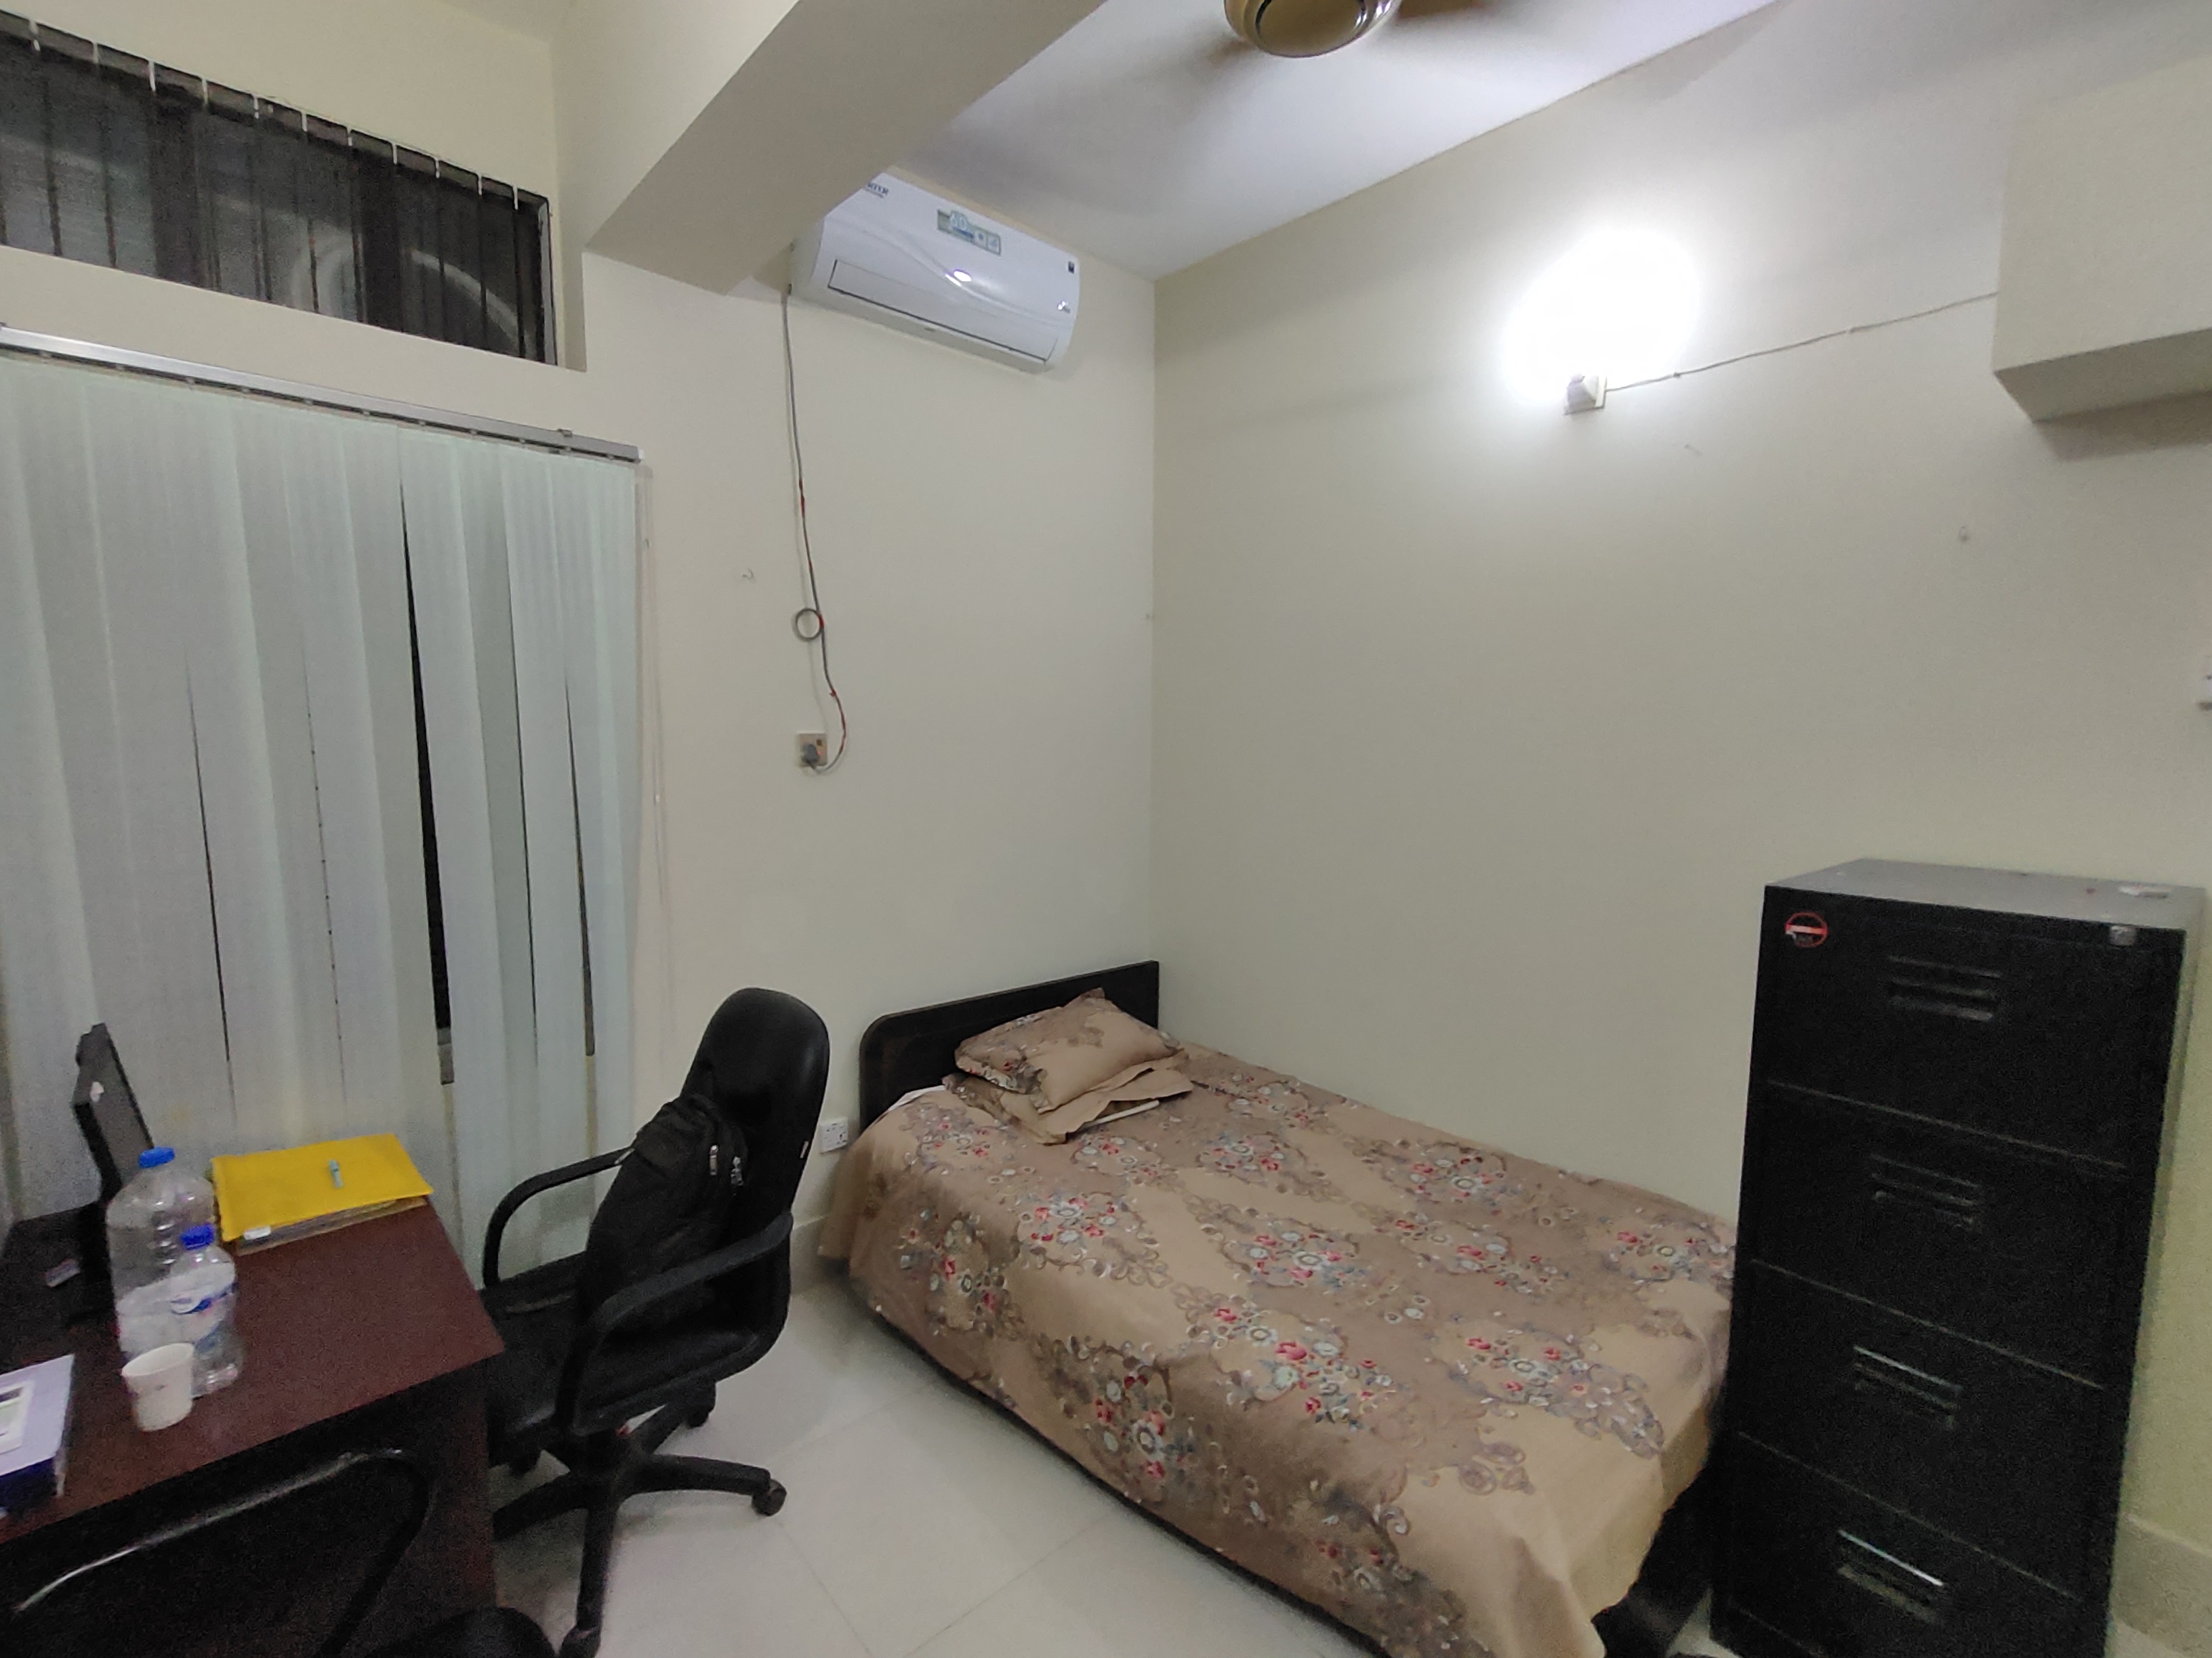
Renovated Doctors Rest Room

Slide 23
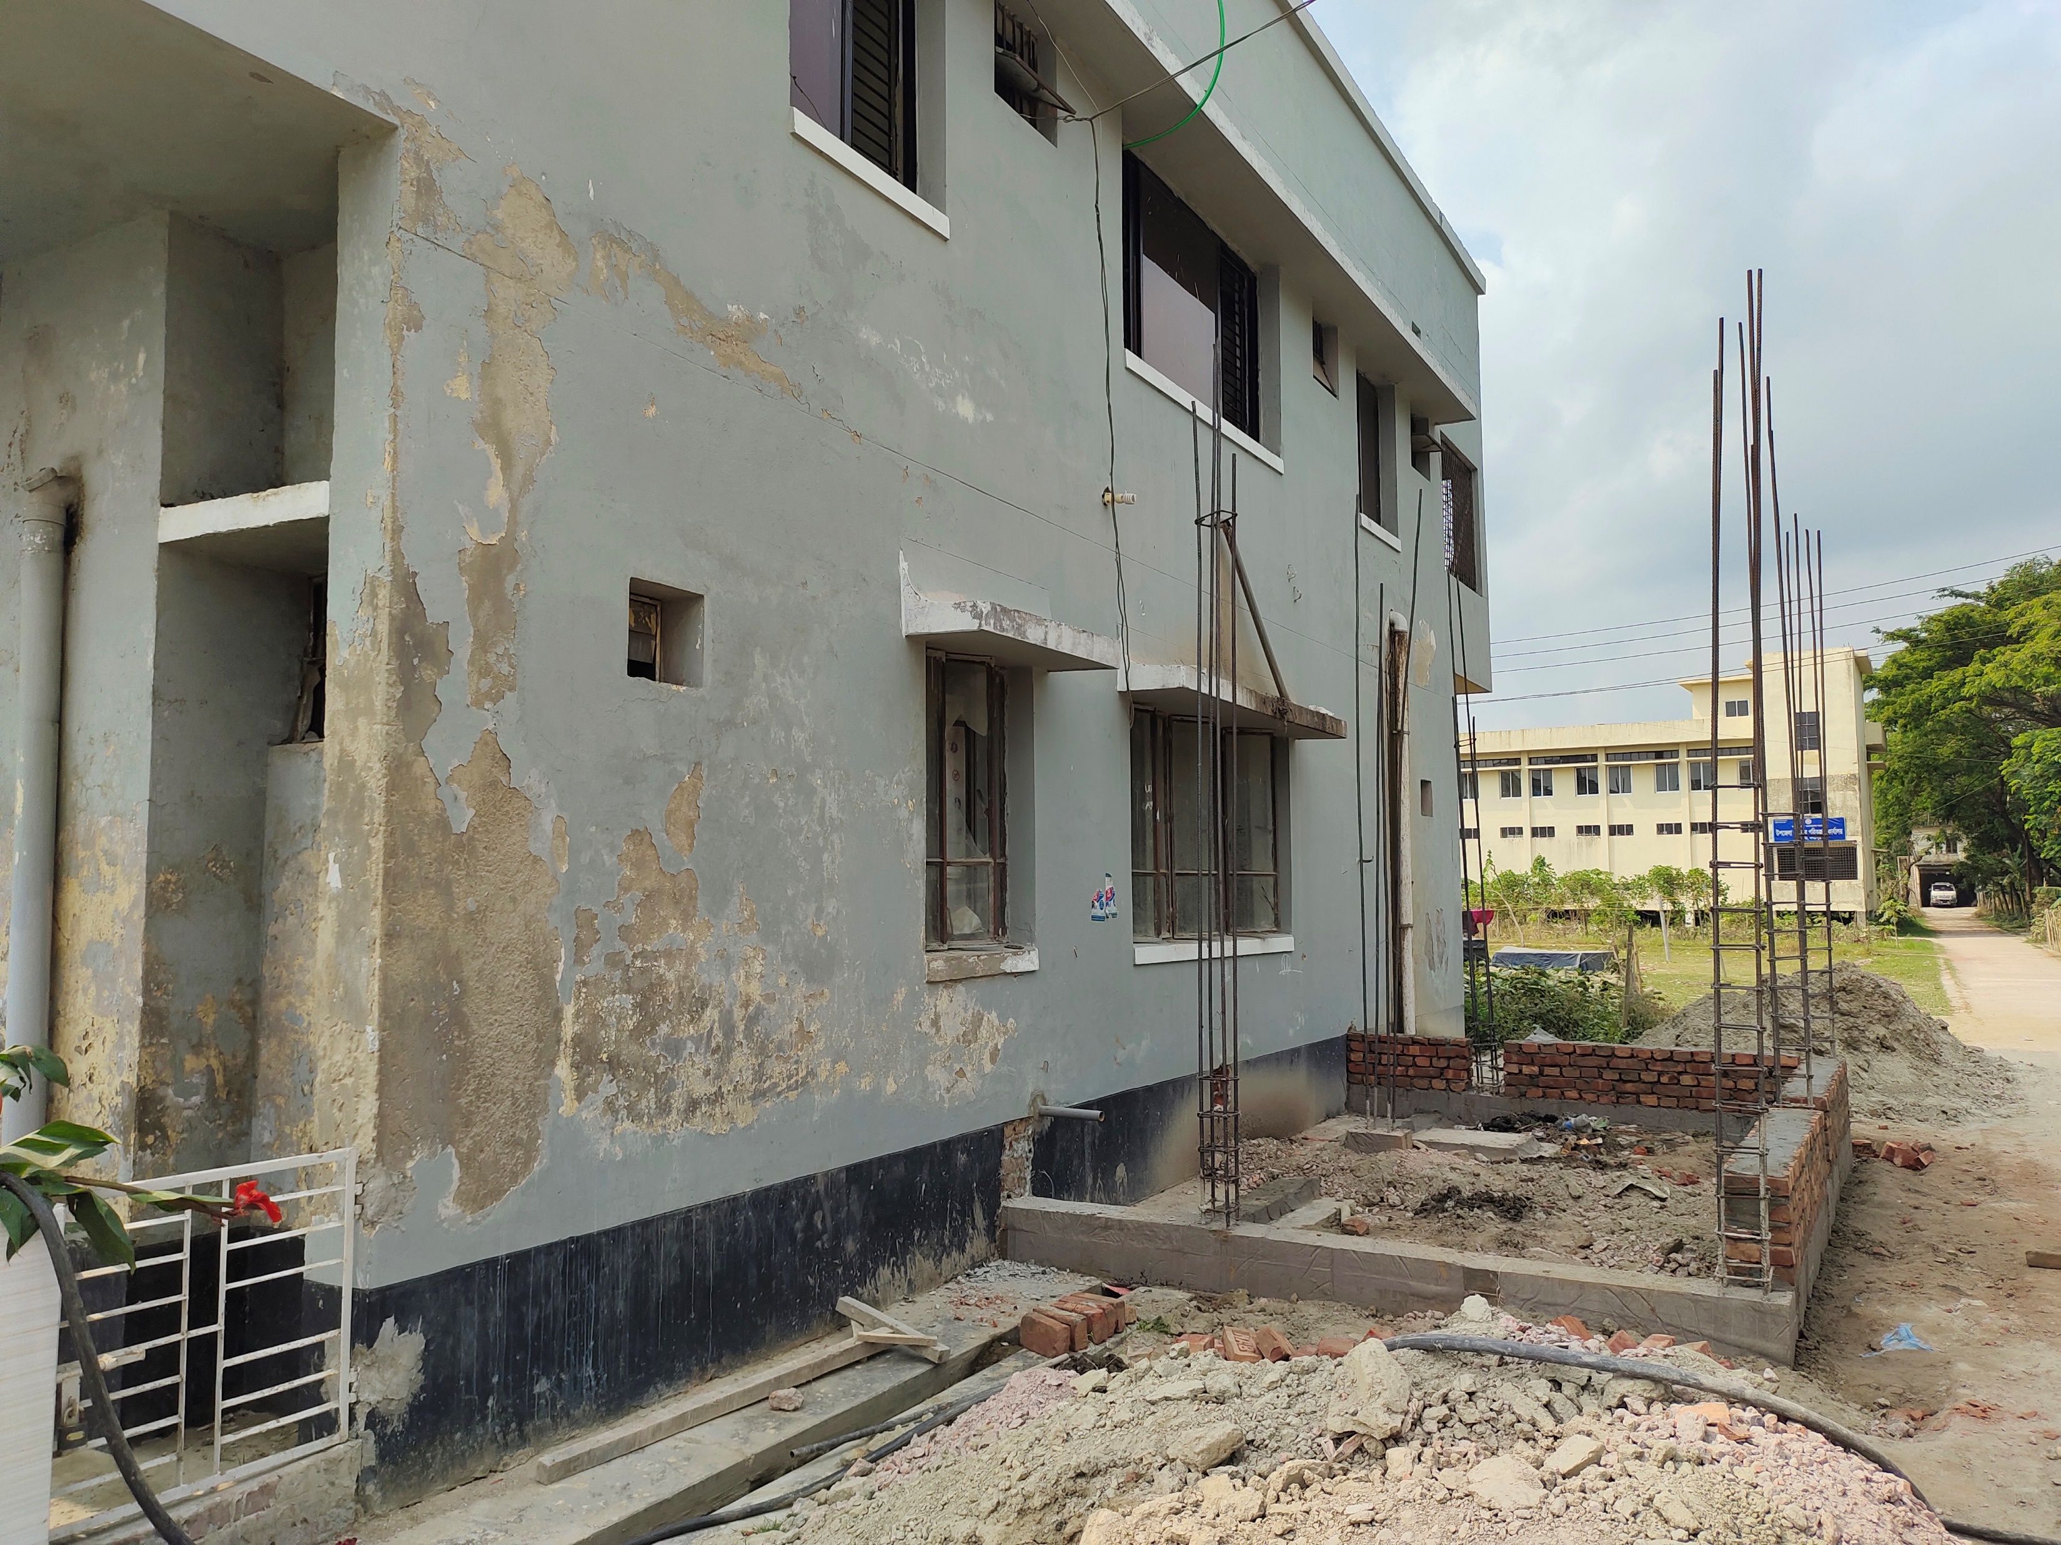
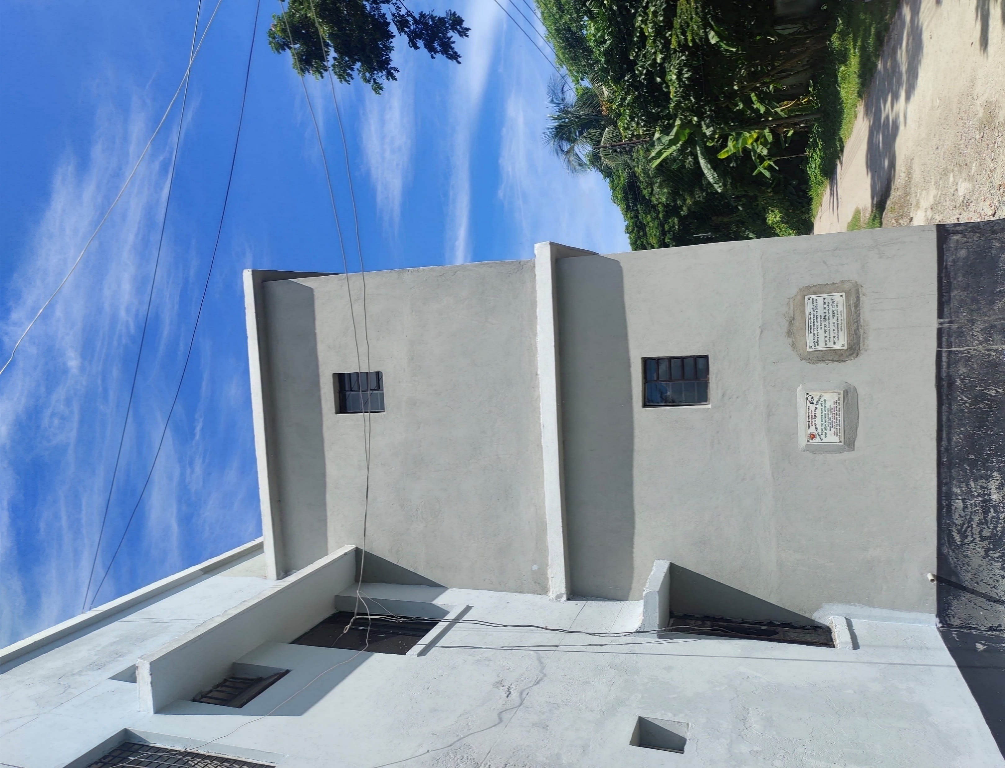
Ensuring clean sanitation
Newly built washroom for patients
BEFORE
AFTER

Slide 24
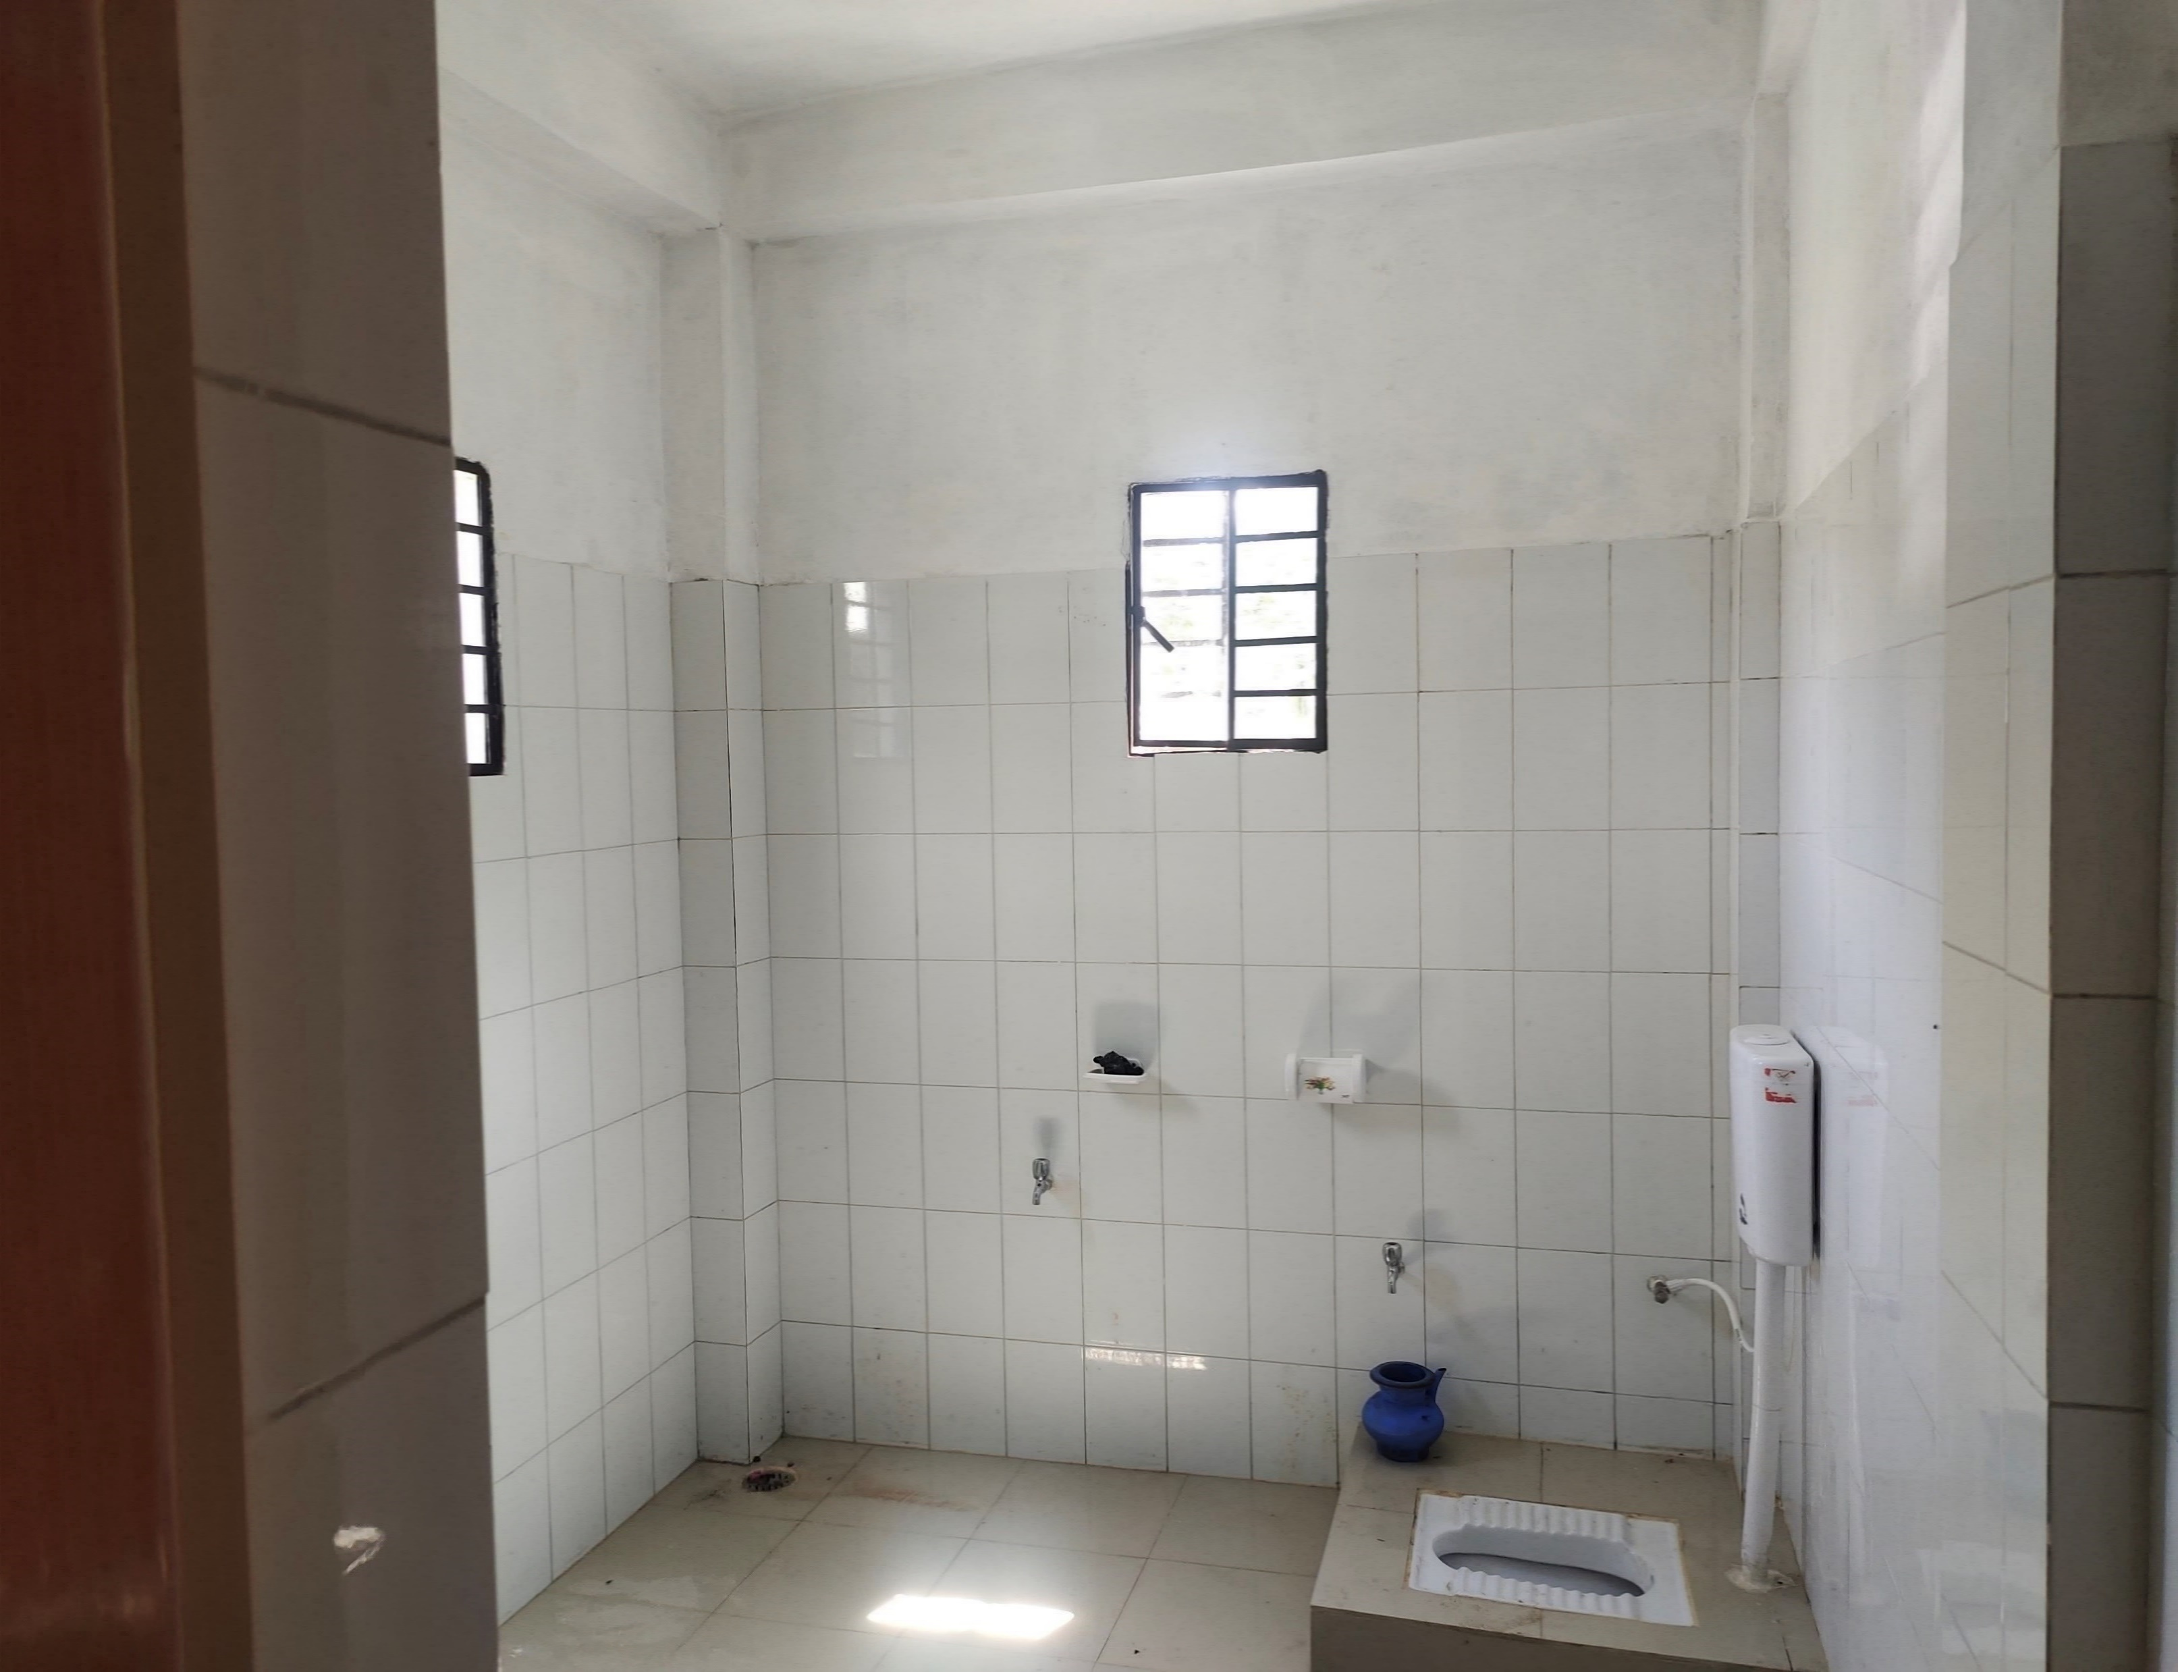
Newly built washroom for patients
INTERNAL VIEW

Slide 25
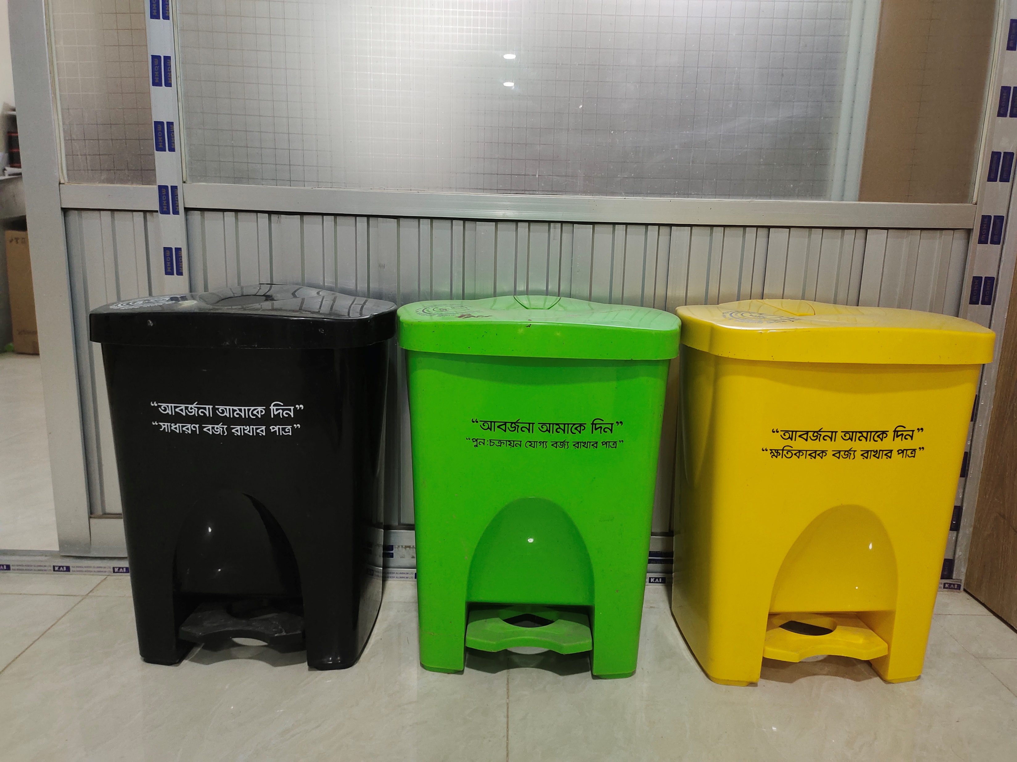
Waste Management
COLORED WASTE BIN

Slide 26
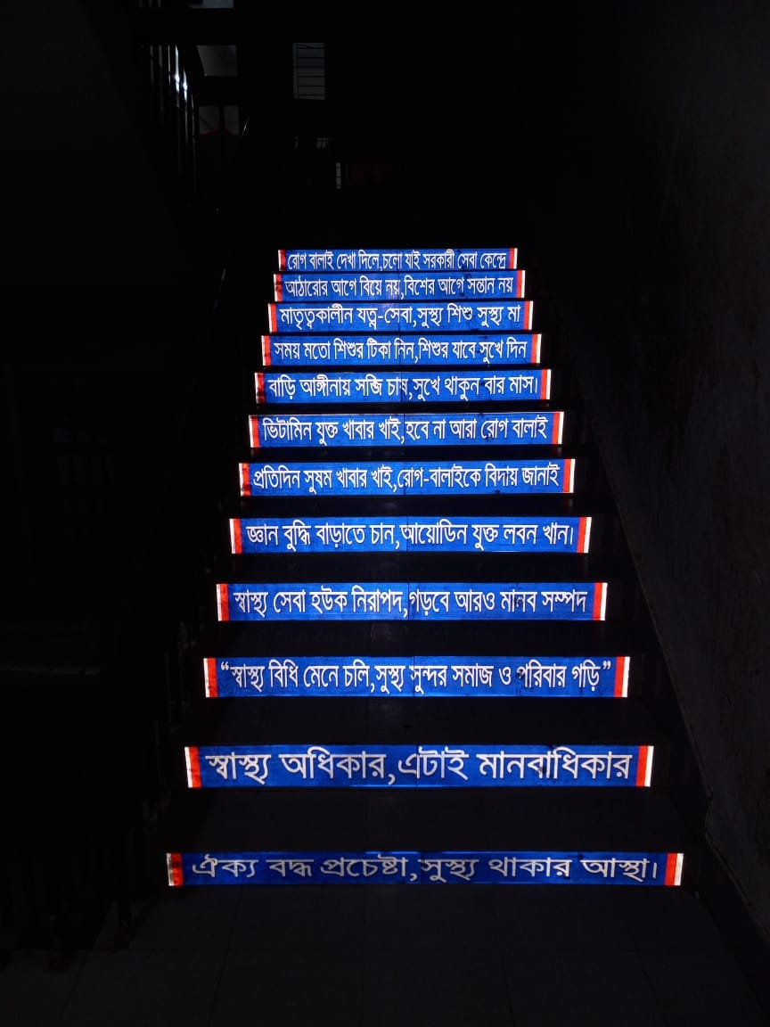
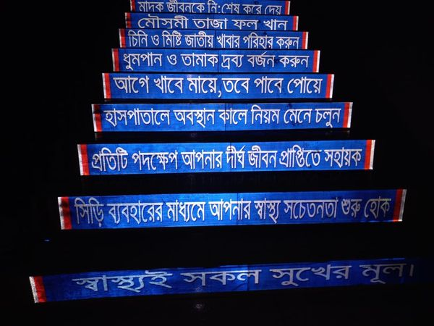
One step = One health message

Slide 27
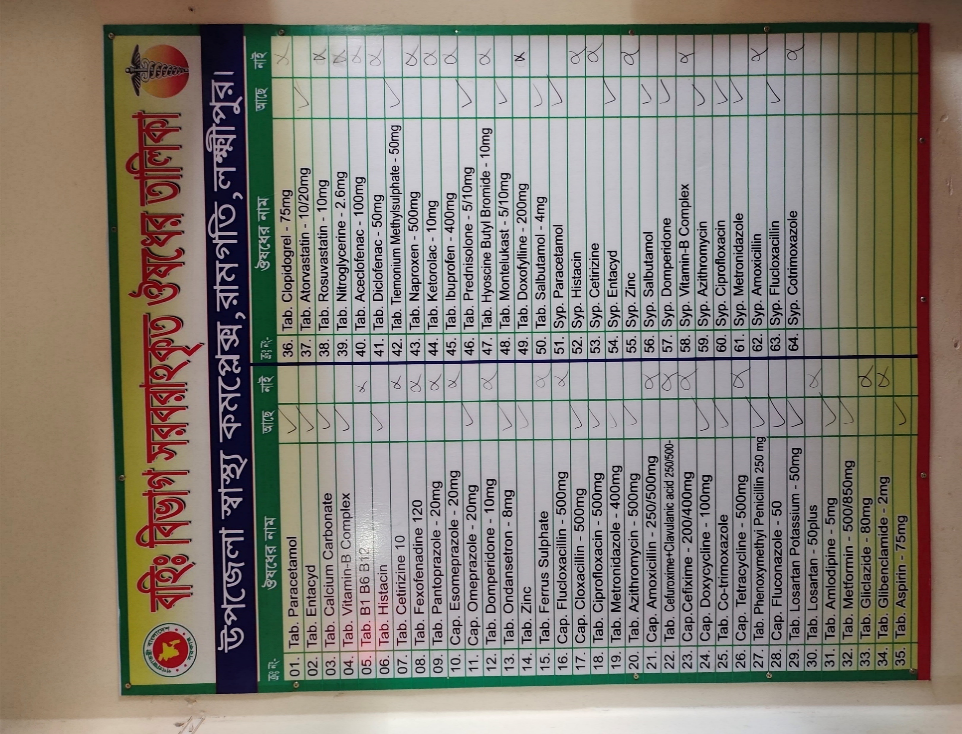
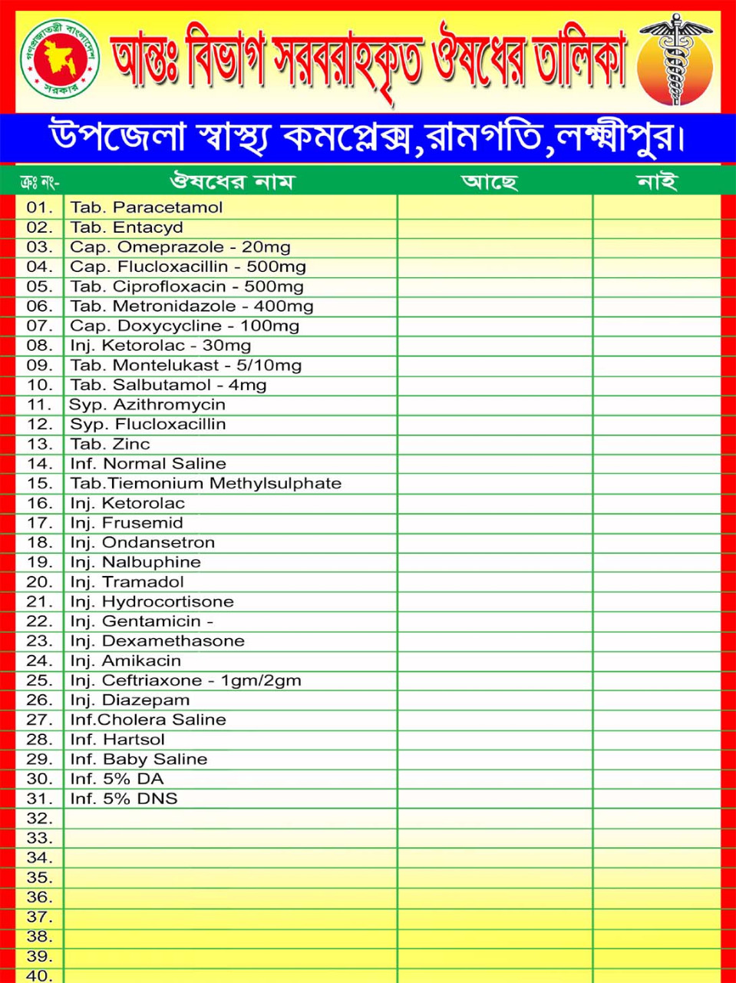
Drug list Display Board (Outdoor And Indoor)

Slide 28
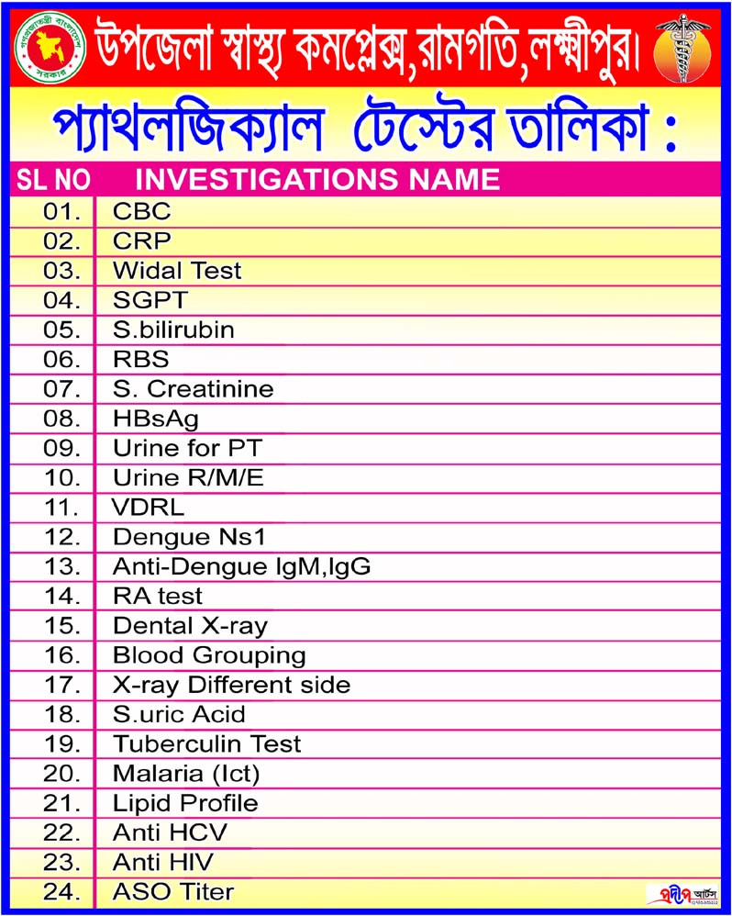
Pathology Test Display Board
24 type of test are carried out at or pathology Lab

Slide 29
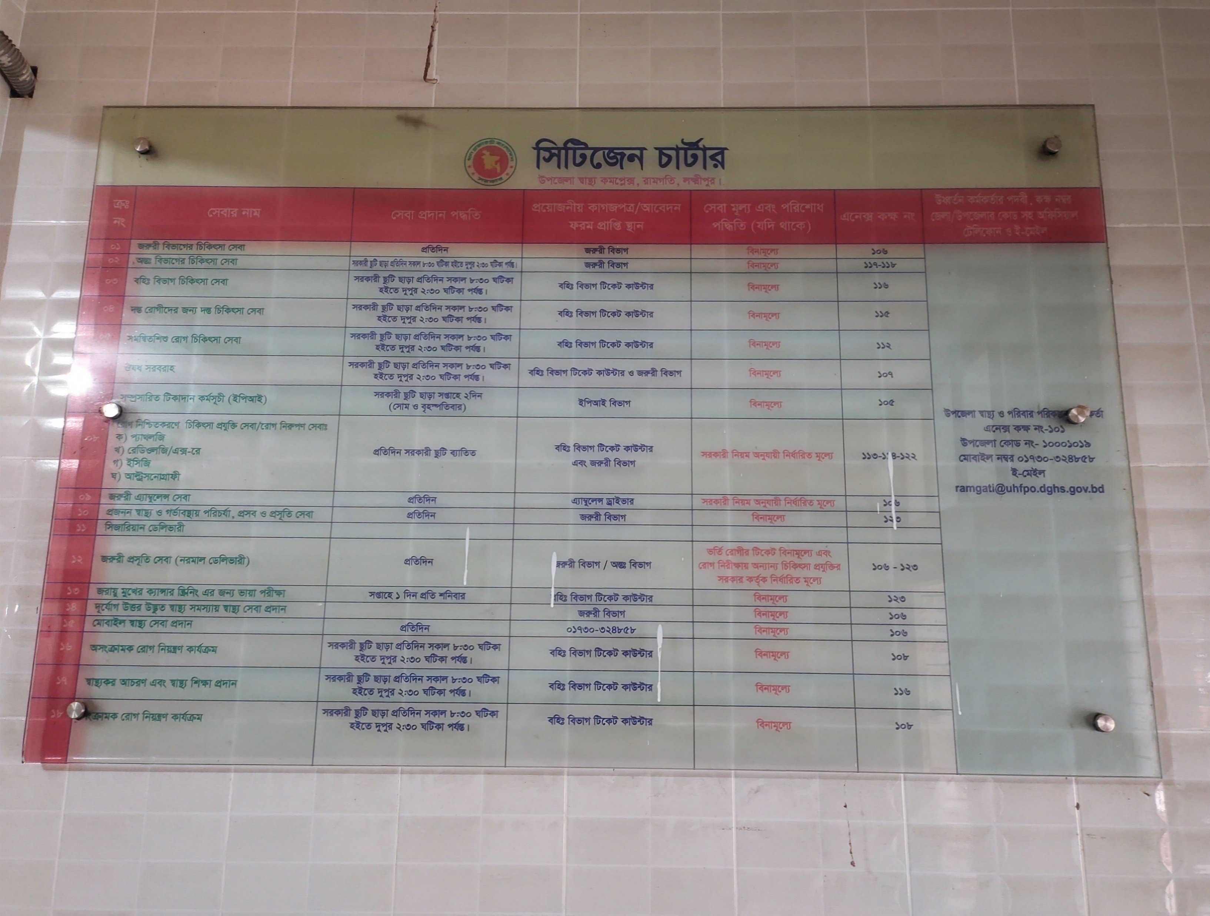
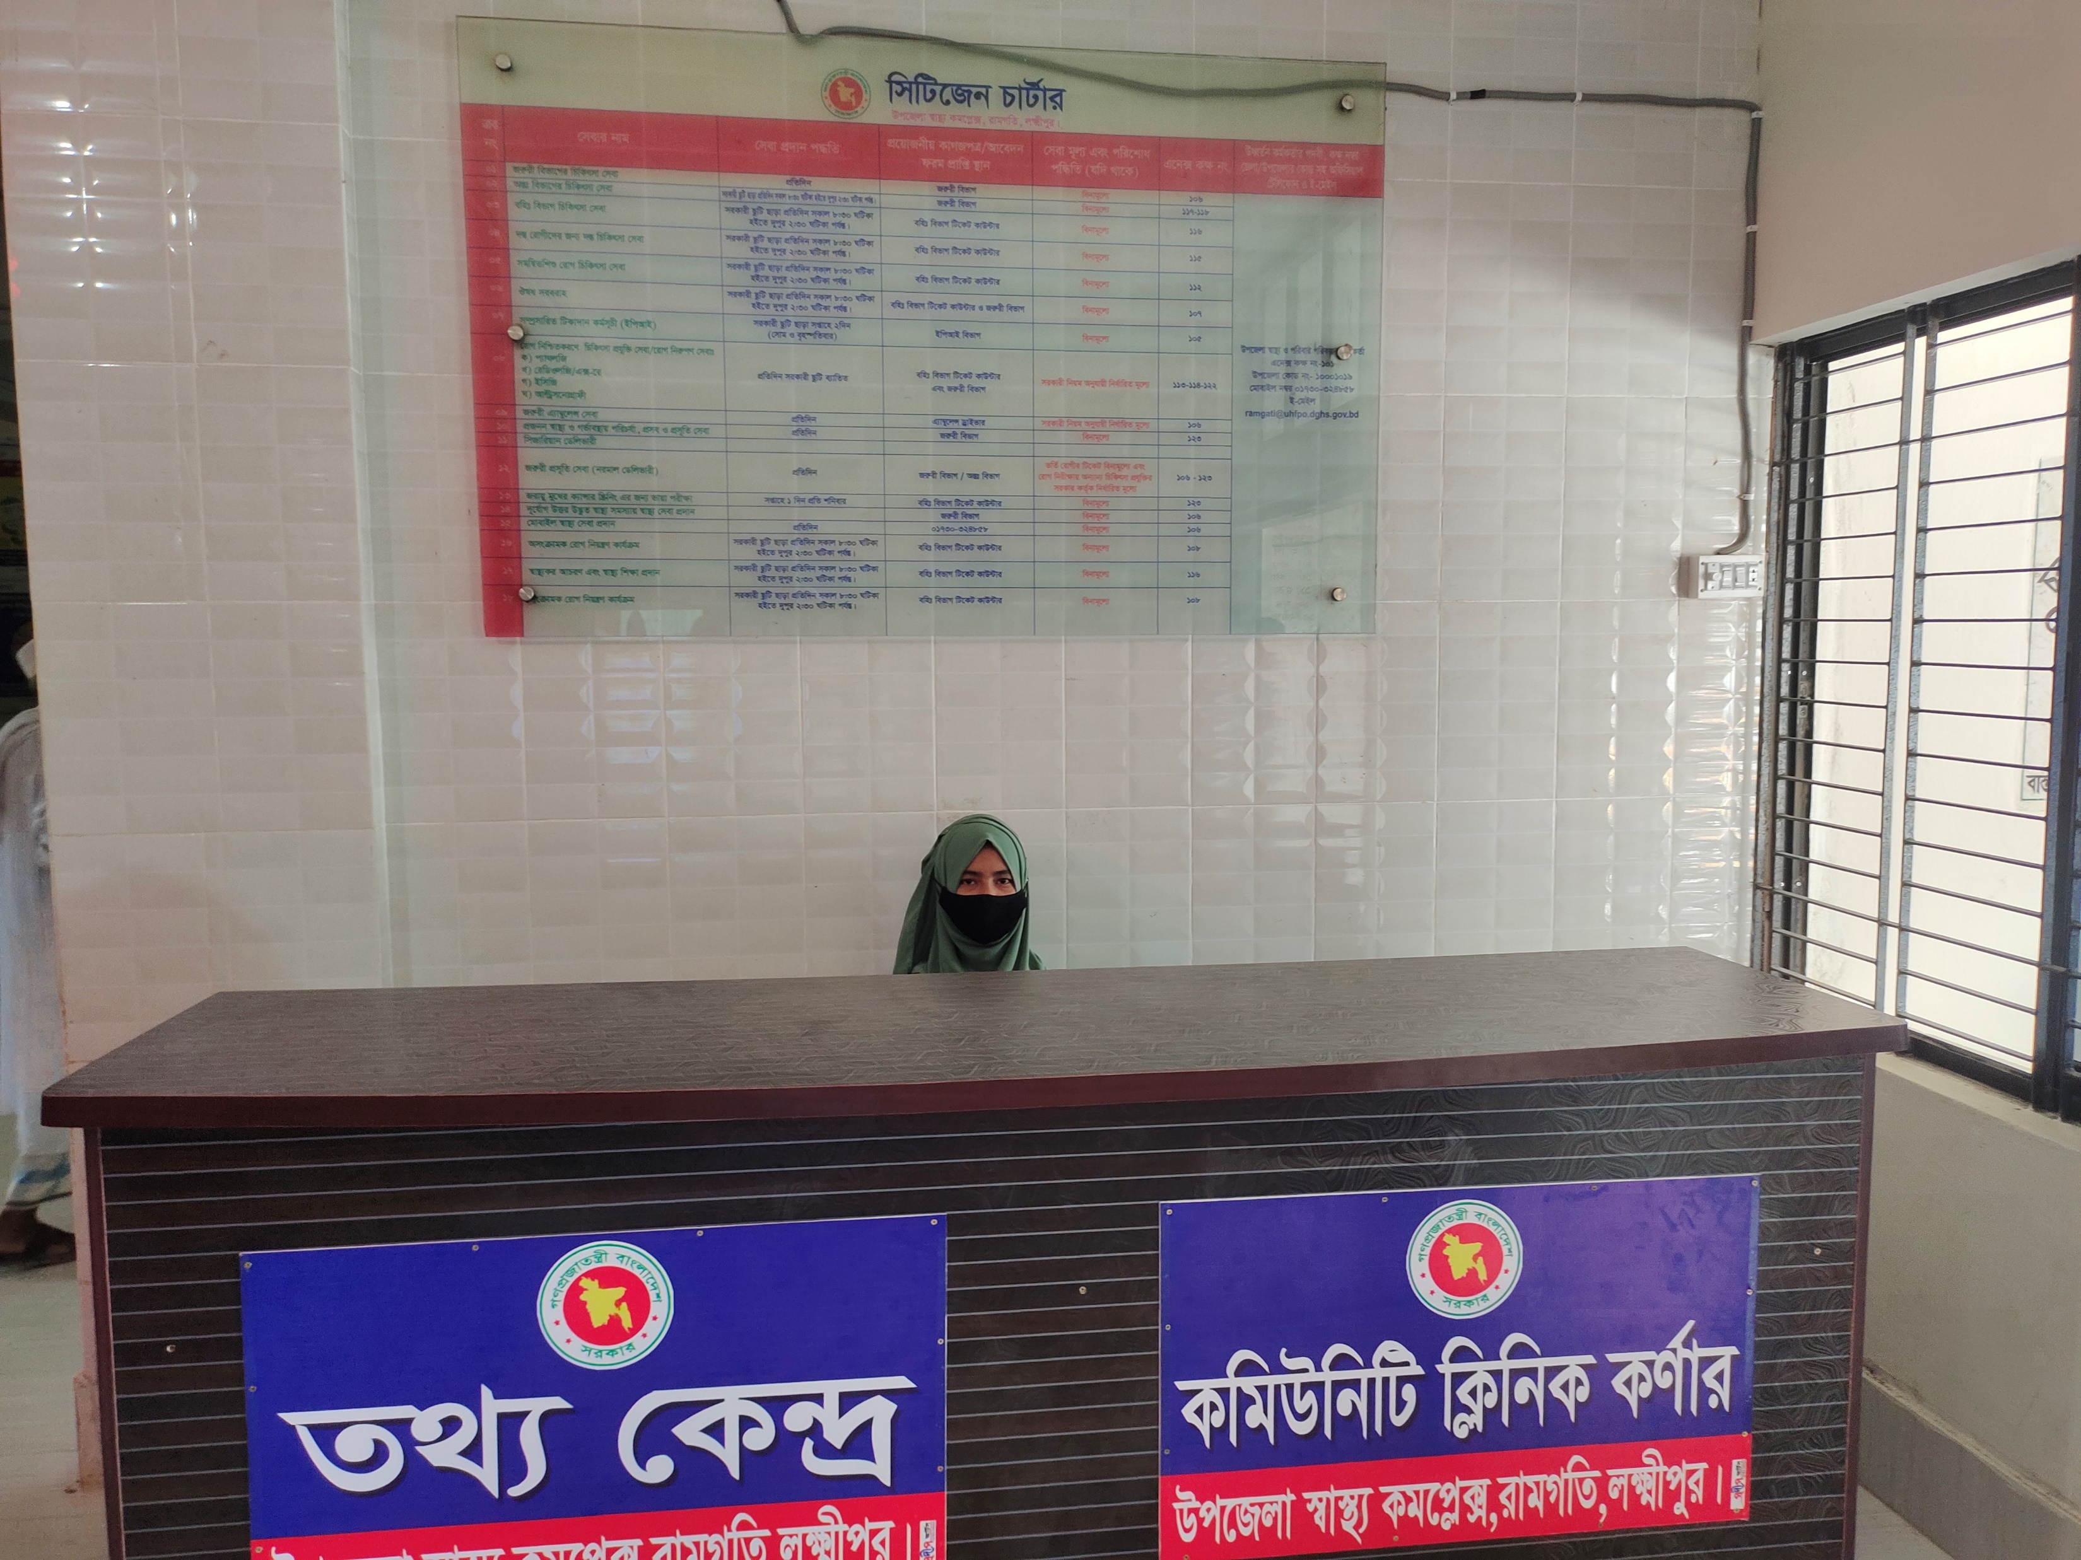
CITIZEN CHARTER AND INFORMATION CENTRE

Slide 30
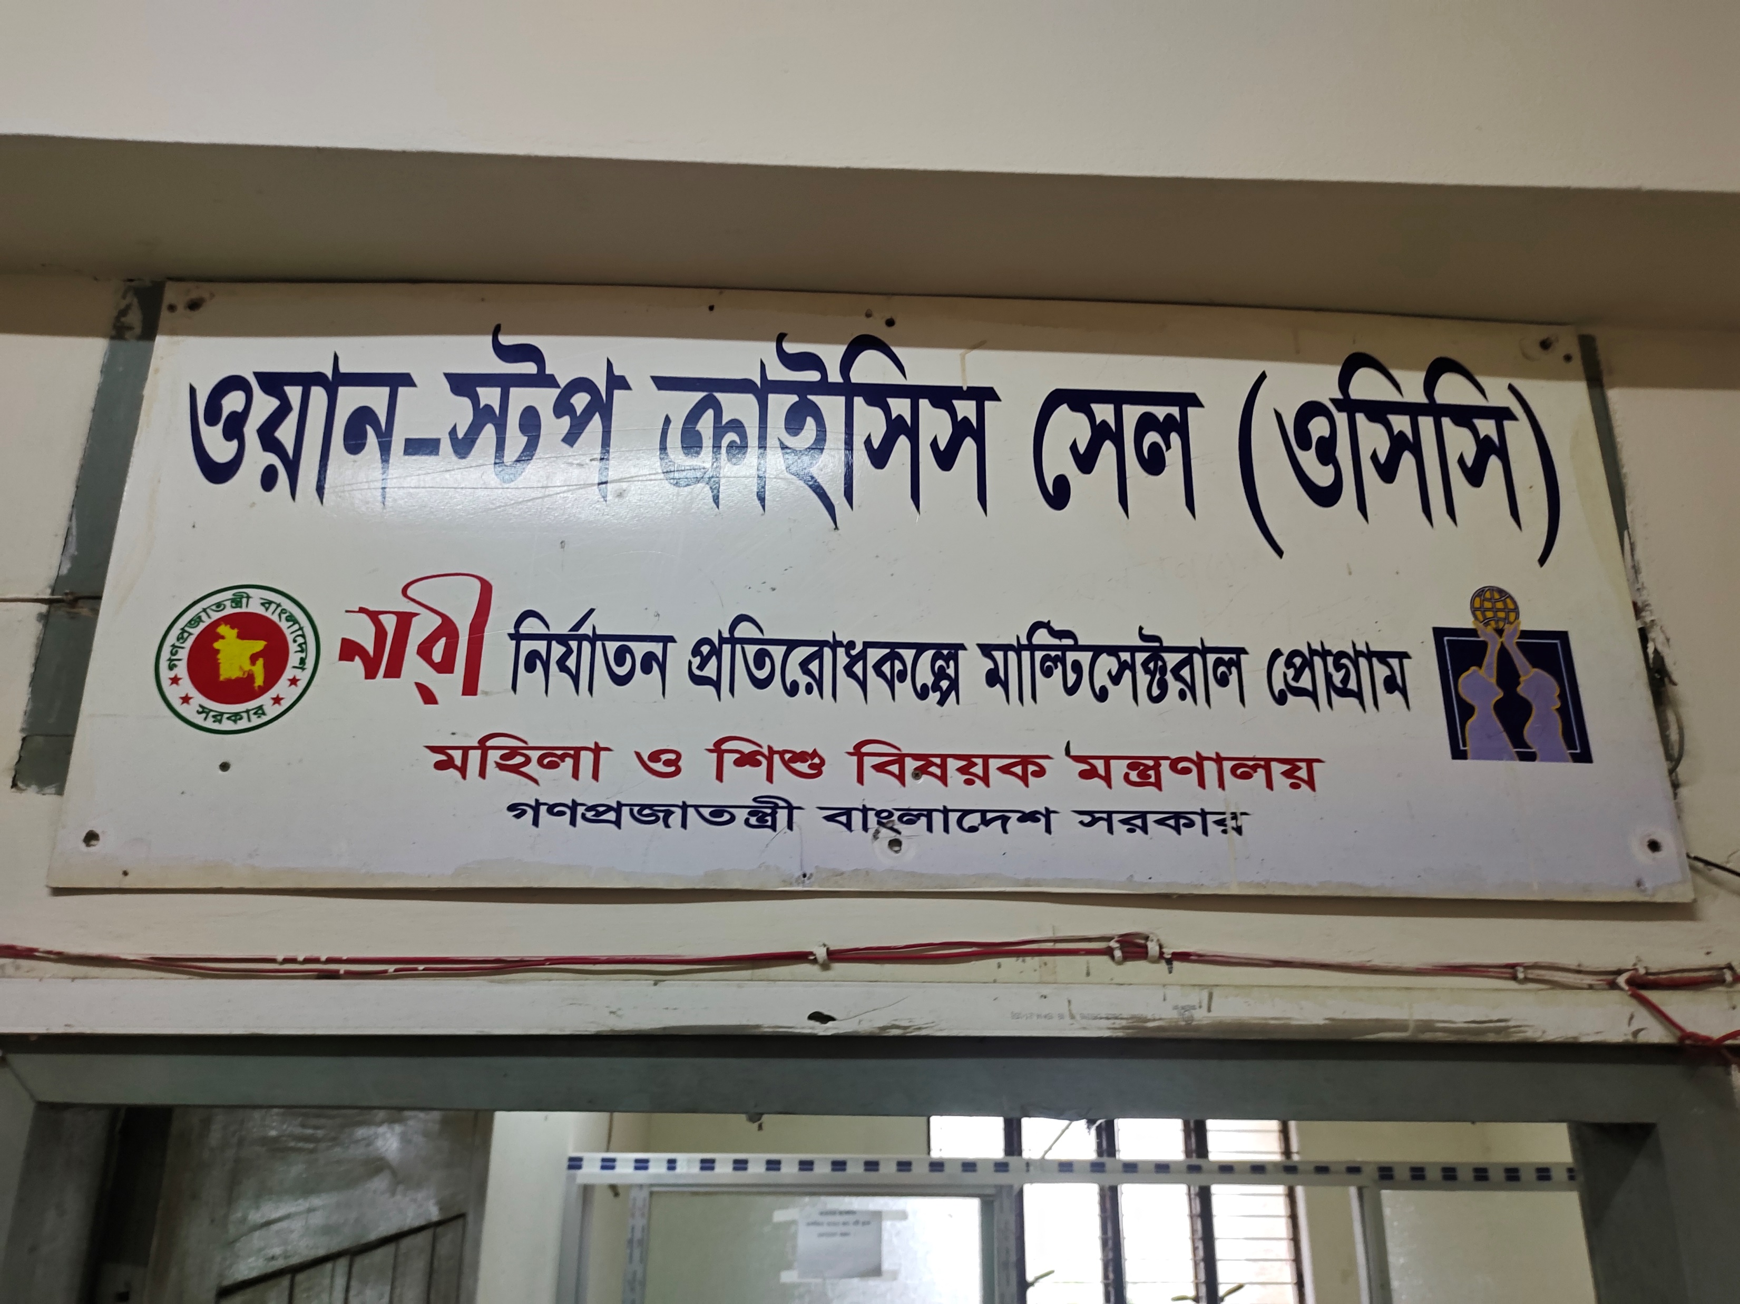
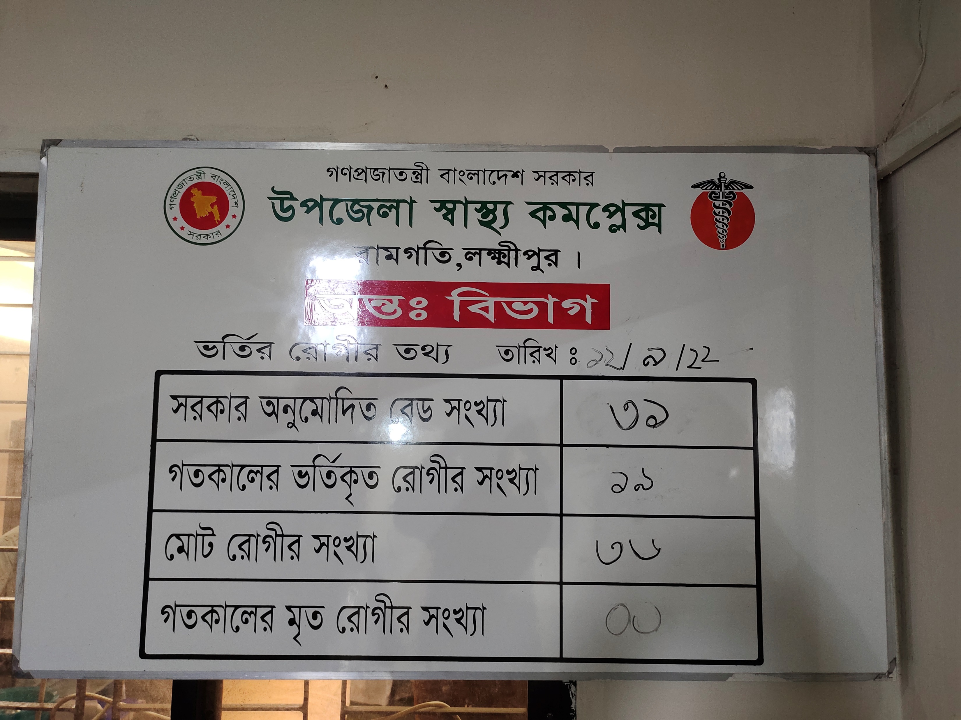
We deeply condemn any violence
One stop crisis cell helps women suffering from any violence
Display board showing number of indoor patients .Which helps to provide information to people taking hospital treatment

Slide 31
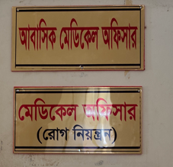

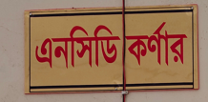
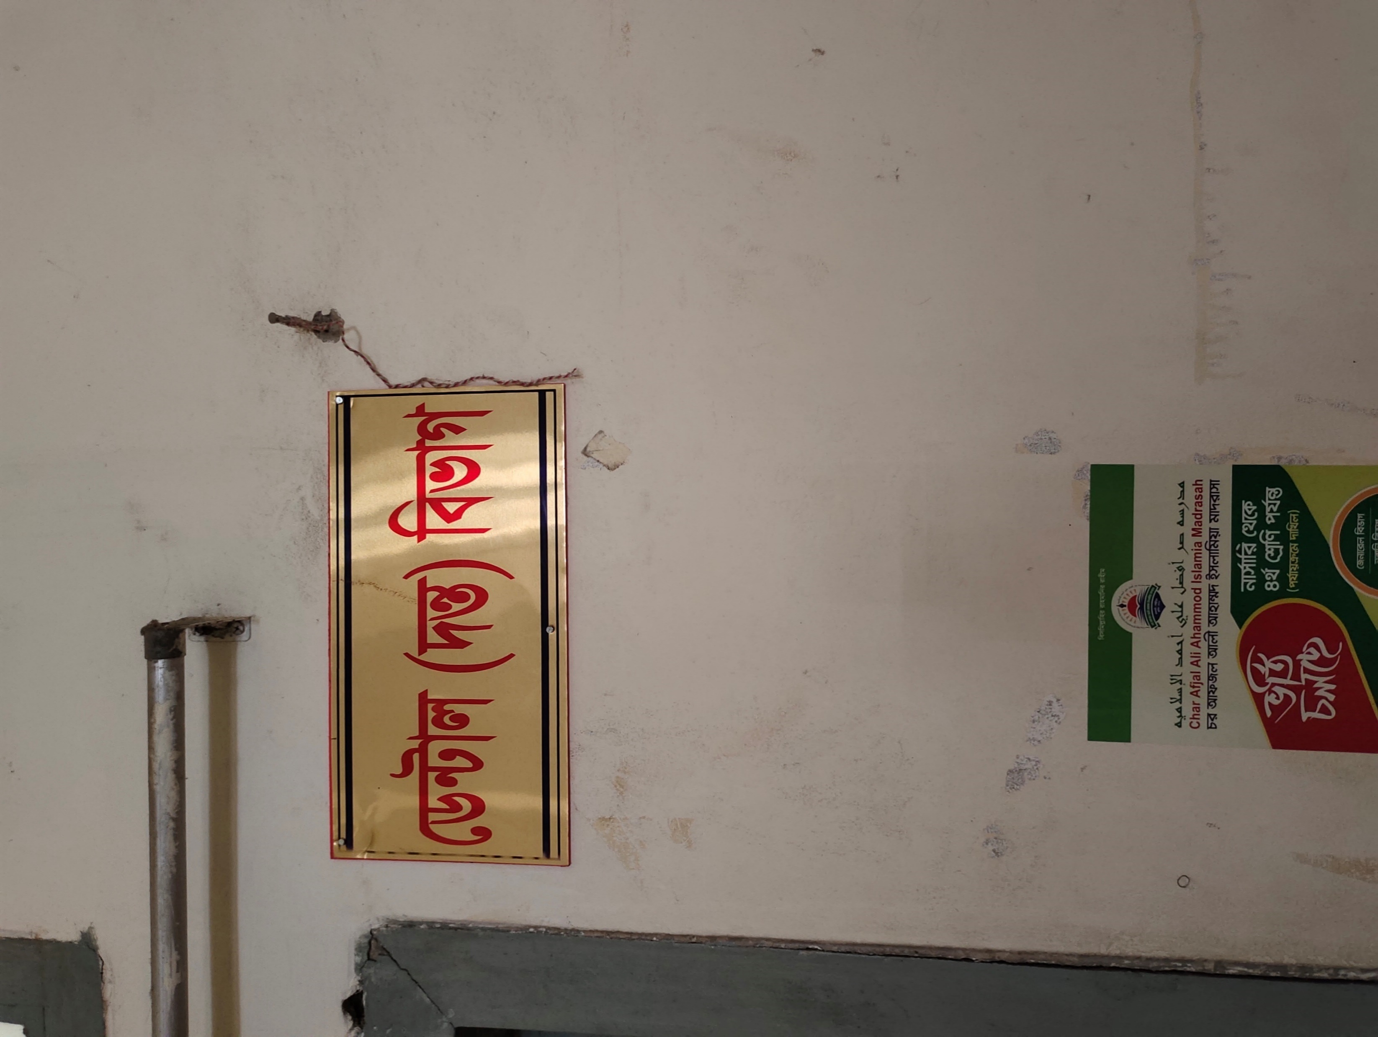

Nameplate For easy Identification

Slide 32
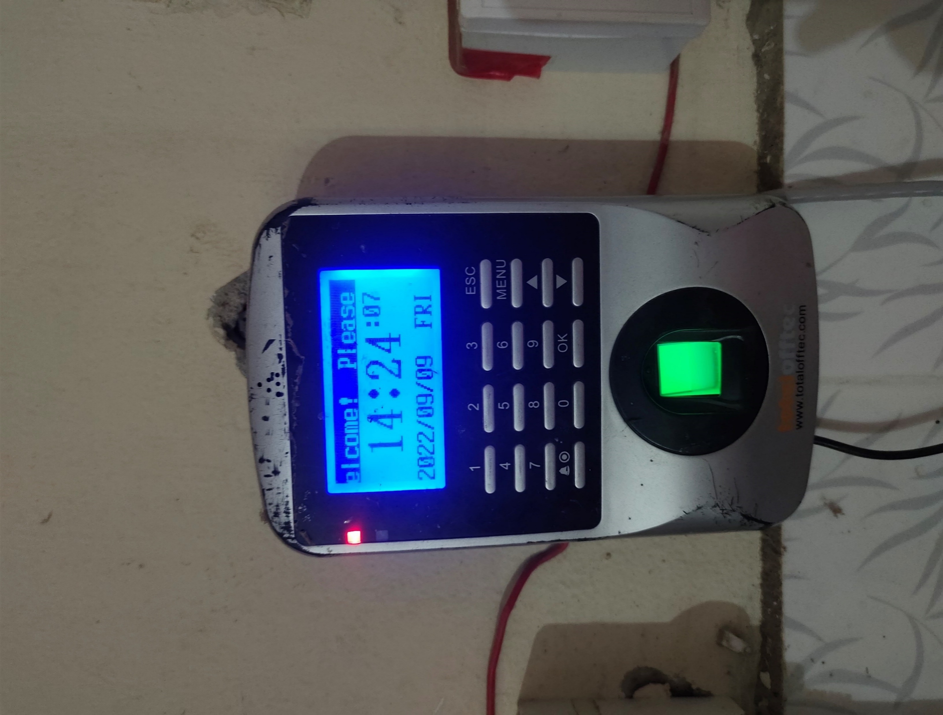
Ensuring Good Governance
Biometric Attendance Machine
-Every day the data is updated
-Necessary to overview and ensure accountability

Slide 33
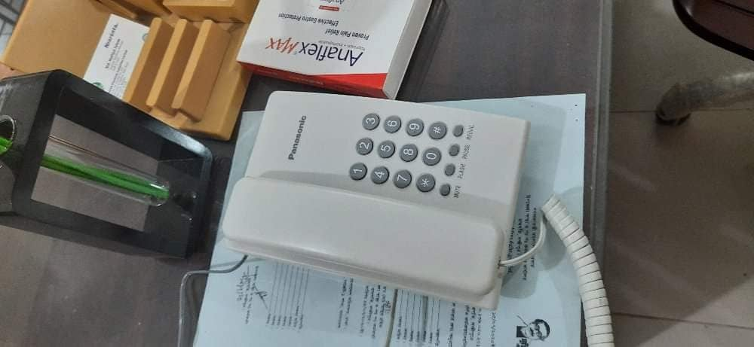
Ensuring Proper Communication
For ensuring proper communication between health work force UHC Ramgati has own intercom system.

Slide 34
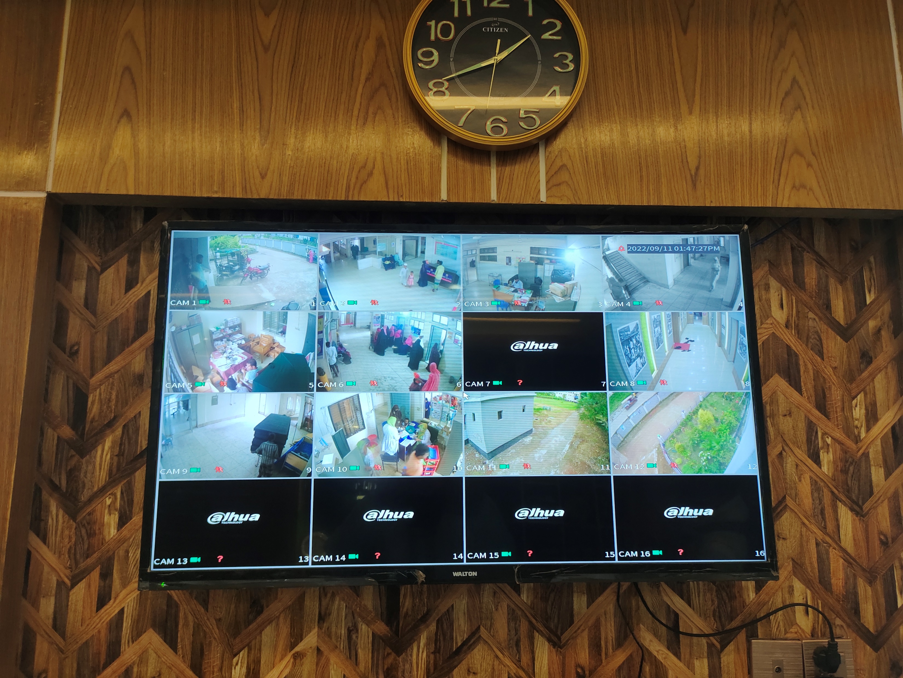
Maintaining Hospital Security
CCTV camera is installed in the hospital premises

Slide 35
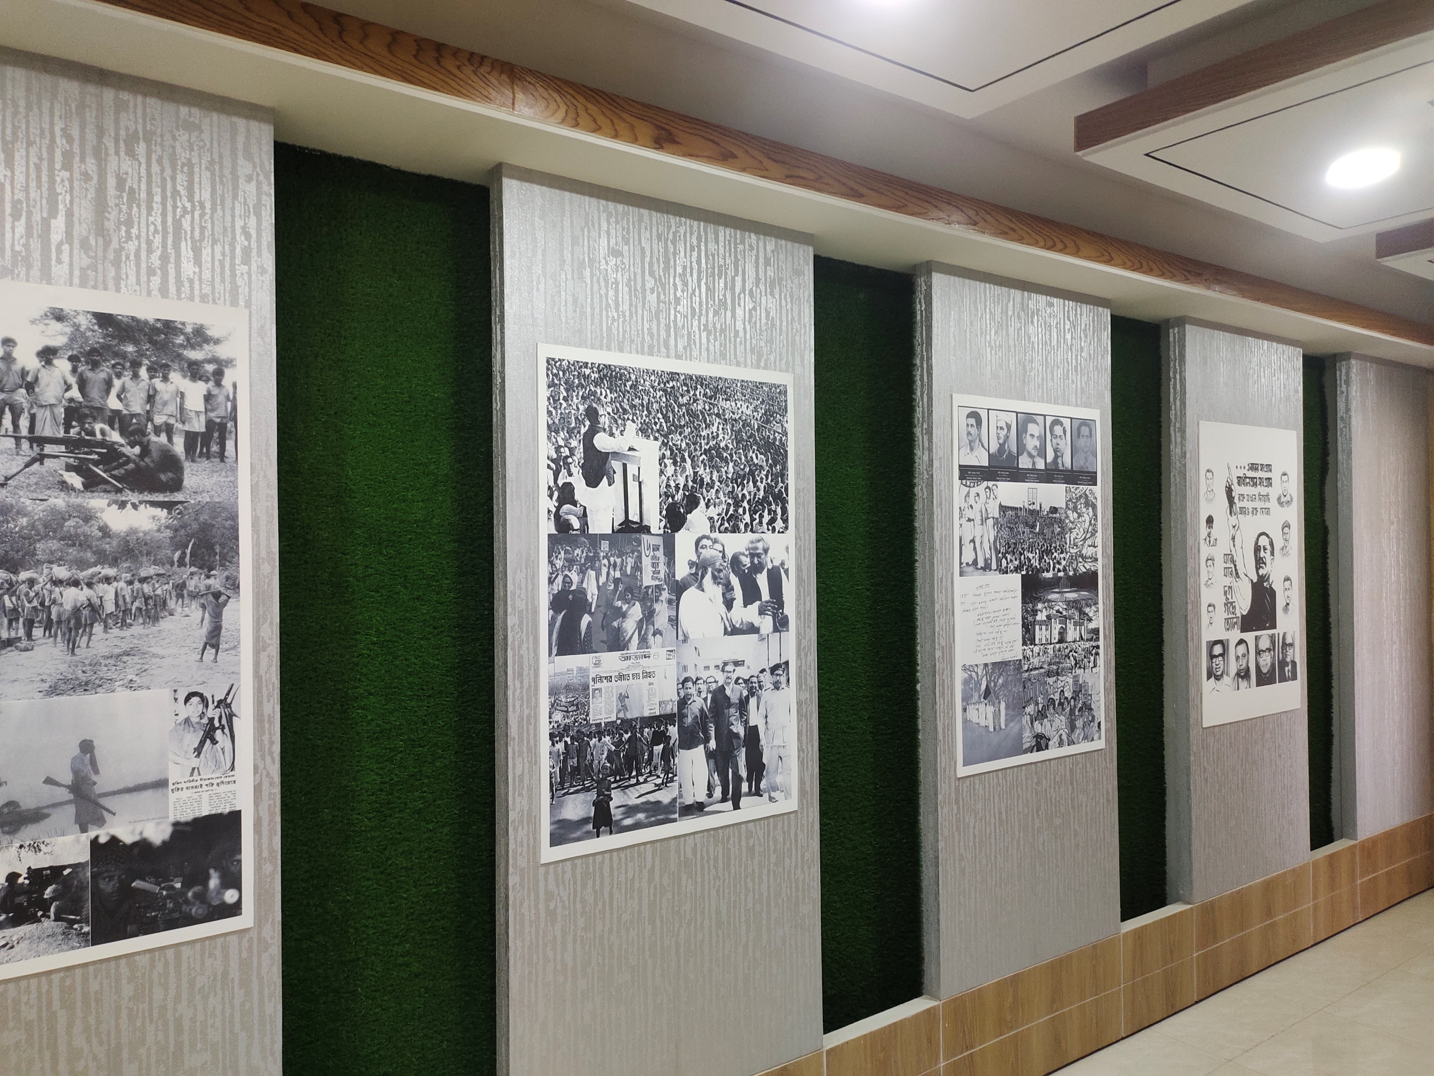
A tribute to Father of the Nation
BANGABANDHU CORNER

Slide 36
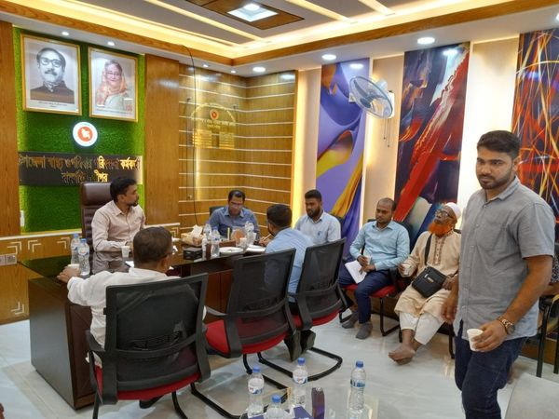
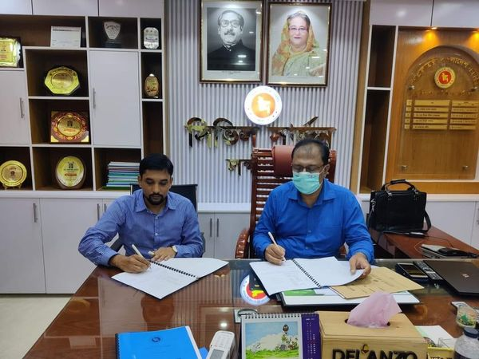
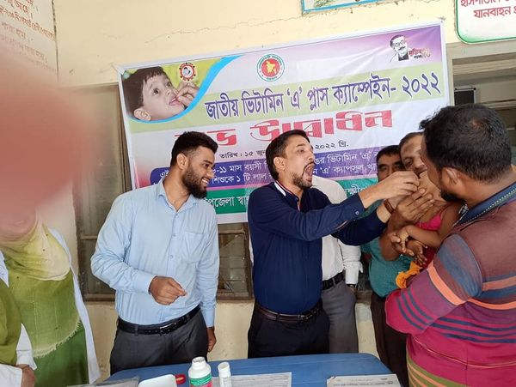
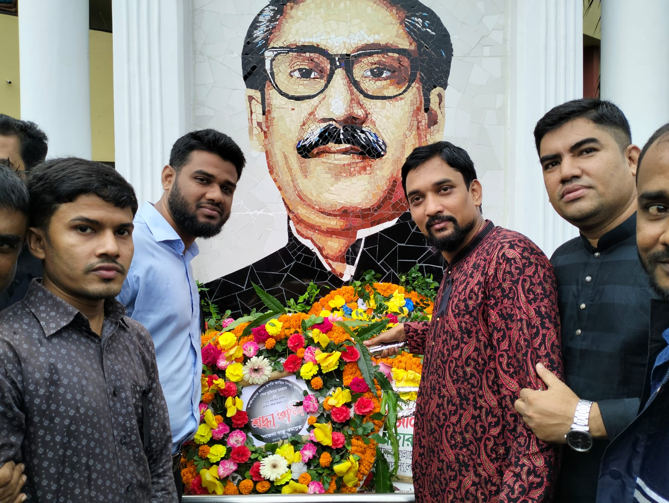
MONTHLY MEETING
APA AGREEMENT AT CS OFFICE
NATIONAL VIT A PLUS CAMPAIGN
15 AUGUST PROGRAMME

Slide 37




COMPLAIN BOX FOR SUGESTION
RABIES IMMUNIZATION
Digital Display Board

Slide 38

CONFERENCE ROOM
BEFORE
AFTER

Slide 39


Training For Health Workers
Capacity
Building
Training
SB3 Training

Slide 40
TEAM RAMGATI
UNITED WE STAND ,DIVIDE WE FALL

Slide 41
THANK YOU

